Slide 1
Application Delivery Fundamentals 2.0 B:
Prometheus Grafana Open Telemetry Telegraf and Mimir

Slide 2
Goals
Observability Concepts
Overview of OpenTelemetry,Telegraf,Prometheus,Grafana and Mimir
Prometheus fundamentals
PromQL
Instrumentation and Exporters
Alerting & Dashboarding
Alerting advanced
Alert Manager HA
Prometheus Federation
Grafana

Slide 3
Observability
Observability is the measure of how well the internal states of a system can be inferred from knowledge of its external outputs.
Often confused with monitoring, observability goes a step further by identifying issues in a system and why those issues occur.
It’s from control theory and has become super crucial in software engineering, especially with the rise of complex, distributed systems and microservices.
Observability collects data from metrics, logs, and traces, the three pillars, to give a complete view of a system’s health and performance.

Slide 4
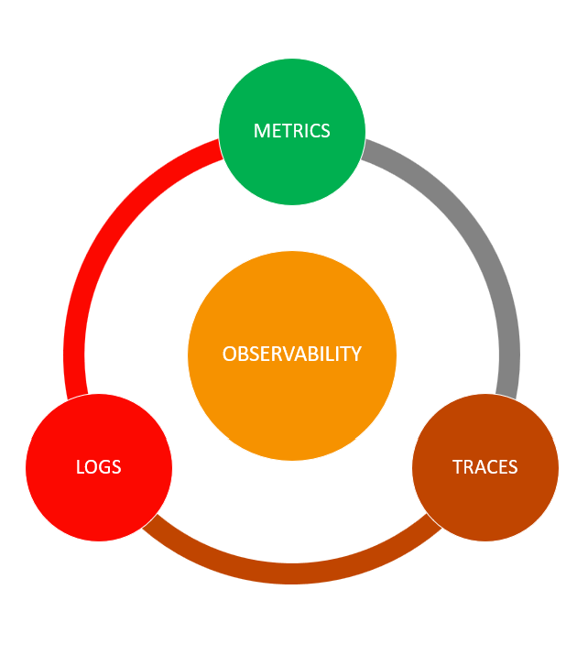
Observability

Slide 5
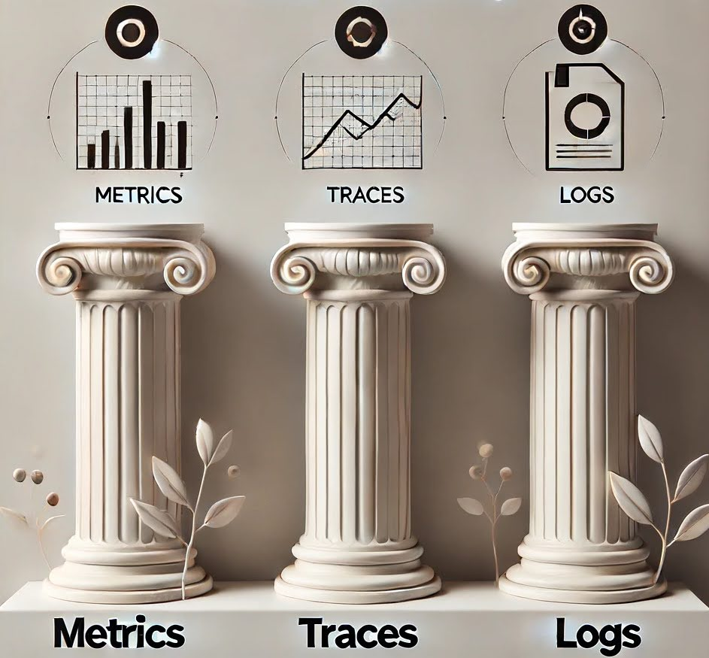
Observability

Slide 6
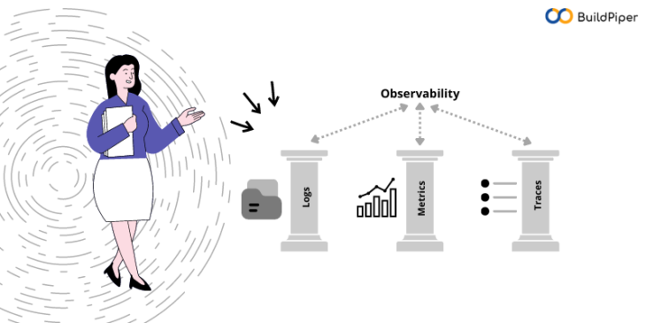
Observability

Slide 7
Need for Comprehensive Observability
Less downtime: Faster detection and fixing means reduced downtime and more customer service.
Better decisions: With visibility into system performance, management can make better decisions on resource allocation and strategic improvements.
Develop and run faster: Developers and ops teams can catch bottlenecks or failures before they become big problems.
Better customer experience: Smoother system operation means less customer friction and better service overall.

Slide 8
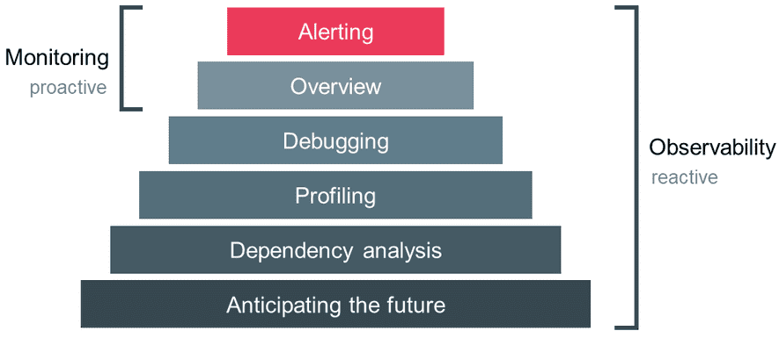
Observability vs Monitoring

Slide 9
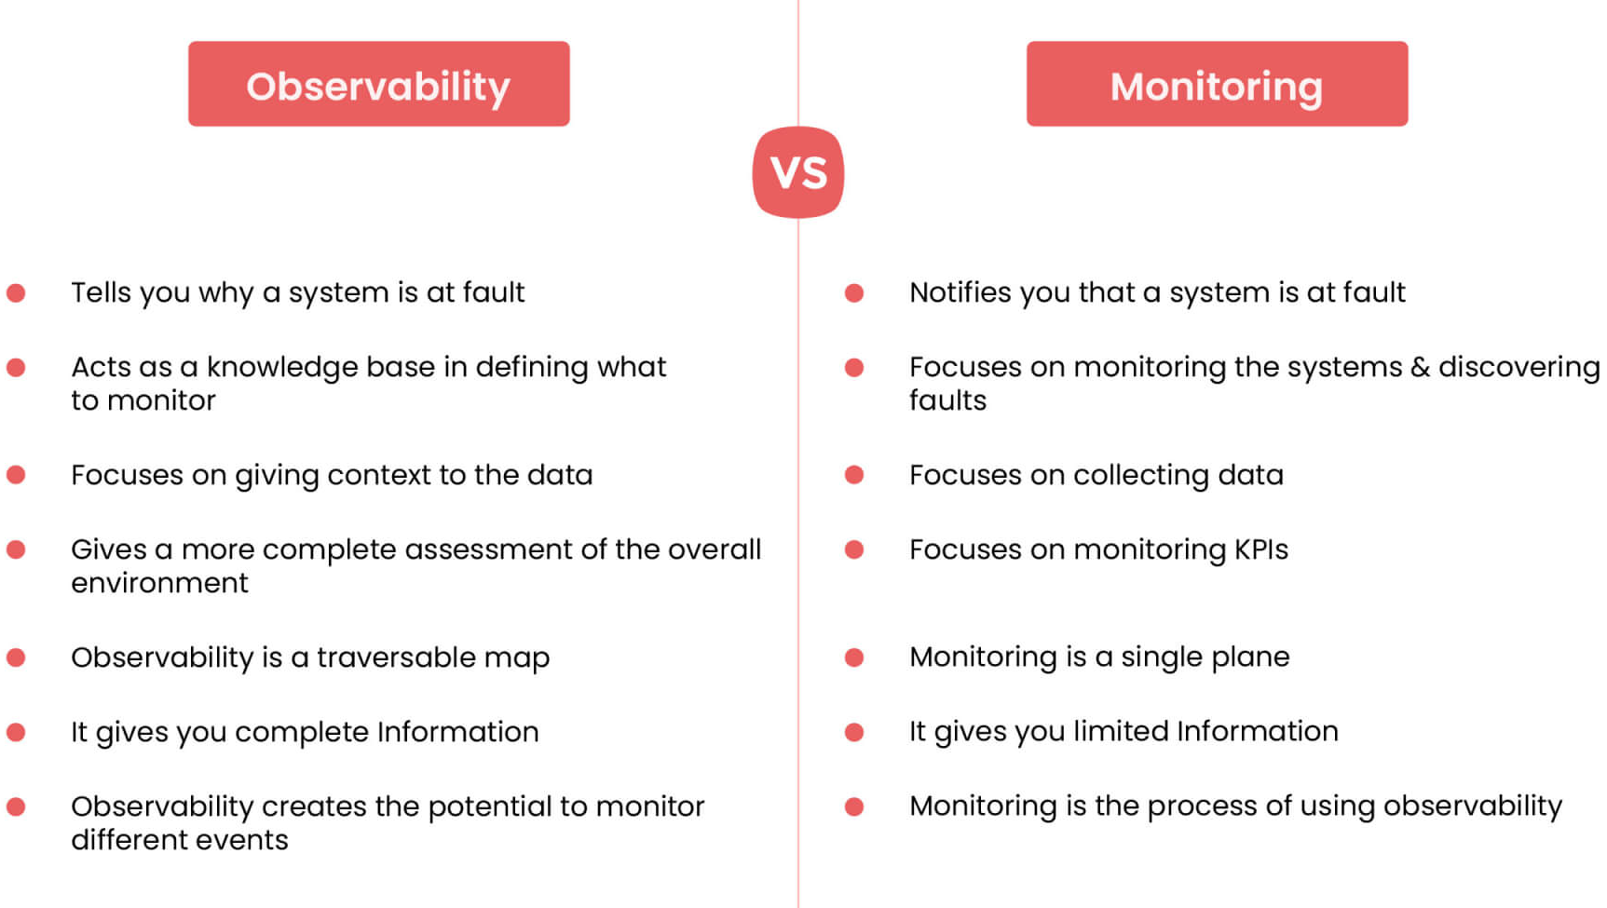
Observability vs Monitoring

Slide 10
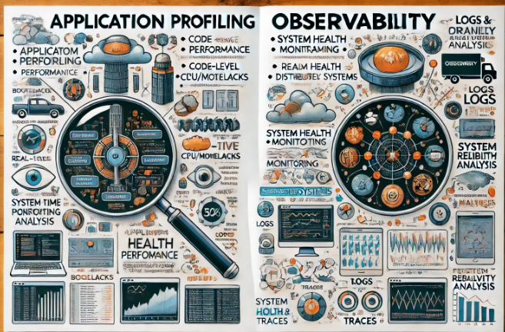
Profiling

Slide 11
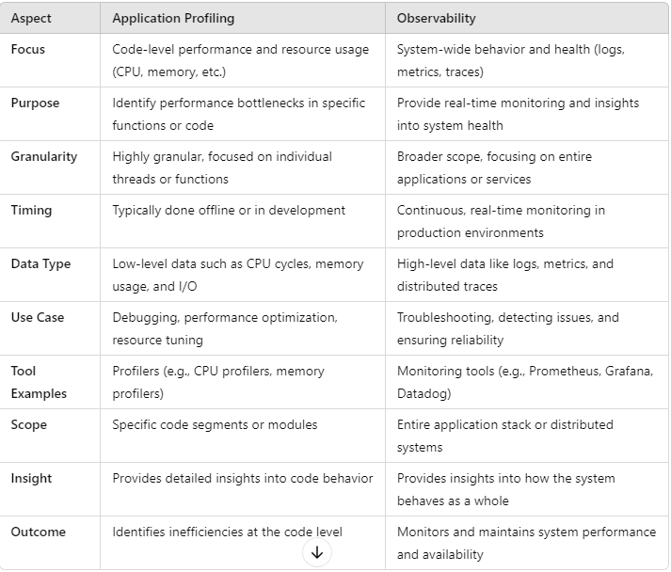
Profiling

Slide 12
Metrics
Metrics" refers to quantifiable measurements used to track and assess the performance or progress of a specific process, activity, or objective.
Metrics are essential in various fields, including business, technology, healthcare, and education, to provide objective data for decision-making, analysis, and improvement.
There are many types of metrics, depending on the context.

Slide 13
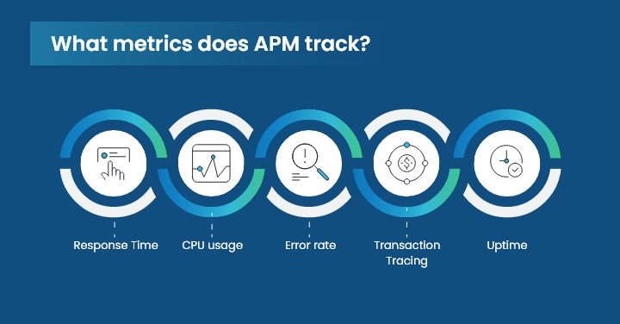
Metrics

Slide 14
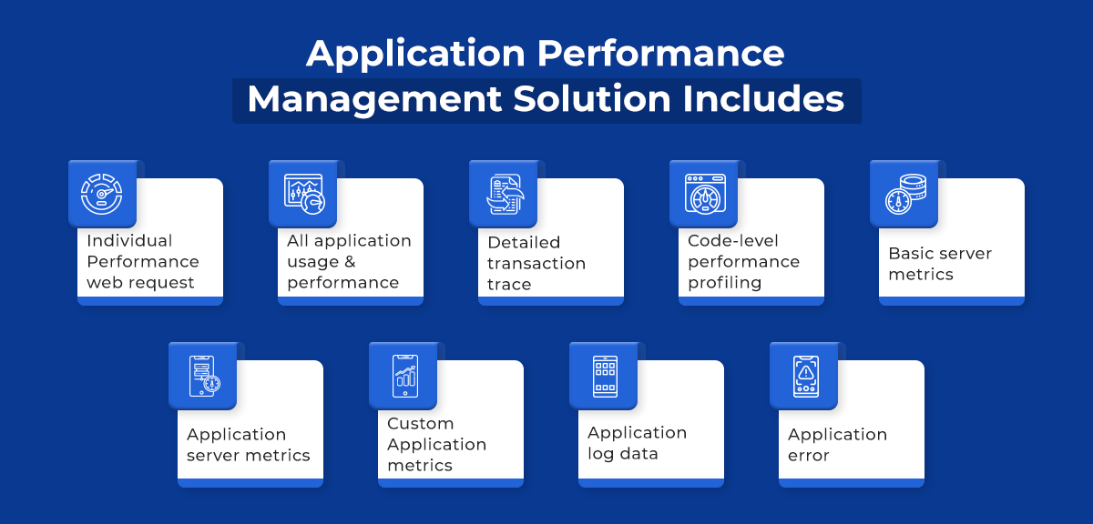
Metrics

Slide 15
Types of Metrics
Business Metrics:
Revenue Growth: Measures the increase in revenue over a certain period.
Profit Margin: Percentage of profit generated from total revenue.
Customer Acquisition Cost (CAC): The cost of acquiring a new customer.
Net Promoter Score (NPS): Measures customer satisfaction and likelihood to recommend a service/product.
Churn Rate: The percentage of customers who stop using a service/product.

Slide 16
Types of Metrics
Financial Metrics:
Return on Investment (ROI): Measures profitability relative to the investment cost.
Gross Profit Margin: A company's total sales revenue minus its cost of goods sold (COGS).
Debt-to-Equity Ratio: A measure of a company's financial leverage.

Slide 17
Types of Metrics
Project Management Metrics:
On-time Delivery: The percentage of projects delivered by the scheduled due date.
Budget Variance: The difference between the budgeted cost and the actual cost.
Scope Changes: Number or percentage of changes made to the project scope.

Slide 18
Types of Metrics
Technology/Software Development Metrics:
Velocity: Measures the amount of work completed during a sprint (agile metric).
Mean Time to Repair (MTTR): Average time to fix a system after a failure.
Defect Density: The number of defects found in each amount of code.

Slide 19
Types of Metrics
Healthcare Metrics:
Patient Satisfaction Score: Measures patient satisfaction with healthcare services.
Average Length of Stay (ALOS): The average number of days a patient spends in the hospital.
Readmission Rates: The percentage of patients who return to the hospital after discharge.

Slide 20
Types of Metrics
Marketing Metrics:
Conversion Rate: The percentage of visitors who take a desired action (e.g., purchasing).
Click-through Rate (CTR): The percentage of people who clicked on a link after seeing an ad or email.
Cost Per Lead (CPL): The average cost of acquiring a lead.

Slide 21
Types of Metrics
Human Resources Metrics:
Employee Turnover Rate: The percentage of employees who leave a company over a given period.
Absenteeism Rate: Measures employee absences as a percentage of the workforce.
Employee Engagement Score: A measure of employees' emotional investment in their work.

Slide 22
Importance of Metrics
Performance Measurement:
Metrics allow organizations to gauge how well they are meeting objectives or standards.
Decision-Making: With data from metrics, businesses can make informed decisions regarding strategy, resource allocation, and priorities.
Benchmarking: Metrics help compare performance over time or against competitors.
Continuous Improvement: Metrics enable tracking of progress and identification of areas needing improvement.

Slide 23
Understand logs and events
Logs and events are essential components in monitoring and analyzing systems, networks, and applications.
They provide critical insights into the performance, security, and operational status of infrastructure, helping in troubleshooting, auditing, and improving overall system health.
Understanding the distinction between logs and events and how they are used can help us better interpret system behaviors.

Slide 24
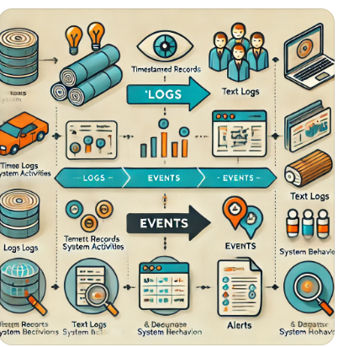
Understand logs and events

Slide 25
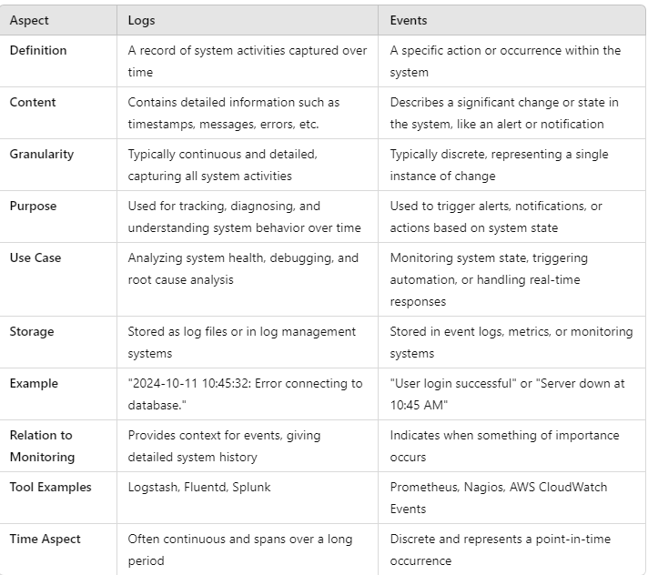
Understand logs and events

Slide 26
Understand logs and events
Logs:
A log is a detailed, time-stamped record of activity generated by systems, applications, devices, or users.
Logs capture various types of information and are used for debugging, auditing, monitoring, and analyzing the state of a system.

Slide 27
Understand logs and events
Characteristics of Logs:
Time-stamped: Logs are usually recorded with the exact time and date when the action or event occurred.
Detailed Information: Logs typically contain detailed information such as user actions, system processes, requests, errors, and system messages.
Continuous Generation: Logs are continuously generated by systems, often creating large amounts of data over time.
Text-based: Most logs are stored as plain text or in structured formats like JSON or XML.
Retained for Auditing: Logs can be stored for long periods to serve as an audit trail of system activities.

Slide 28
Understand logs and events
Types of Logs:
System Logs: Captures operating system-related activities such as boot sequences, services starting or stopping, and system errors.
Application Logs: Records events within an application, such as user requests, database queries, and application errors.
Security Logs: Includes information about user logins, permissions, access control, and failed login attempts.
Network Logs: Logs data about network traffic, firewall rules, and packet exchanges.

Slide 29
Understand logs and events
Examples of Logs:
Web server access logs capturing incoming HTTP requests.
System logs capturing user logins, reboots, or file access.
Error logs generated by applications when an error or crash occurs.

Slide 30
Understand logs and events
Events:
An event is a specific occurrence or action within a system or application, often defined by triggers or conditions.
Events represent key moments that may require attention, such as a security alert, system crash, or significant change in state.

Slide 31
Understand logs and events
Characteristics of Events:
Discrete Occurrences: An event is usually tied to a specific action or change, such as a system startup, security breach, or completed transaction.
Higher-Level Information: Events tend to summarize important activities, unlike logs which may capture more granular data.
Trigger-Based: Events are often triggered by specific conditions or thresholds, such as a system reaching a performance limit, or a user accessing restricted data.
Alerting and Monitoring: Events are often tied to monitoring systems that generate alerts, notifications, or reports for administrators.
Structured Data: Events are often captured in a more structured way, helping systems and humans process them efficiently.

Slide 32
Understand logs and events
Examples of Events:
A user successfully logs in to a system (authentication event).
A network intrusion detection system identifies a potential attack (security event).
A scheduled backup process successfully completes (system event).
An application generates a "transaction completed" event when a purchase is made.

Slide 33
Understand logs and events
Differences Between Logs and Events:
Granularity: Logs are more granular and detailed, capturing every action or change in a system, while events highlight more significant occurrences.
Purpose: Logs are used for detailed analysis, diagnostics, and audit trails, whereas events focus on triggering alerts, monitoring system health, and identifying critical issues.
Data Structure: Logs are often unstructured or semi-structured (e.g., text files), while events tend to be structured and can be more easily parsed by monitoring tools.
Storage: Logs are often stored for a long time to track past actions, while events are typically used in real-time for immediate responses or alerts.

Slide 34
Understand logs and events
Use Cases of Logs and Events:
Troubleshooting: When a system issue occurs, logs help pinpoint the exact sequence of actions that led to the issue.
For example, an error log in a web server could reveal why a particular page failed to load.
Security Monitoring: Security logs and events help detect suspicious behavior such as failed login attempts, unauthorized access, or malware activity.
Event monitoring tools can raise an alert if certain thresholds are breached (e.g., multiple failed login attempts).

Slide 35
Understand logs and events
Performance Analysis:
Logs can capture metrics such as CPU usage, memory consumption, and network traffic, helping administrators detect performance bottlenecks or inefficient processes.
Compliance Auditing: Logs serve as a record of system activity, which is often required for regulatory compliance.
Logs can show who accessed data, when, and what actions were taken.
Real-Time Monitoring and Alerting: Event management systems (like SIEM or APM tools) continuously monitor systems for events that may require immediate action, such as security breaches or system outages.

Slide 36
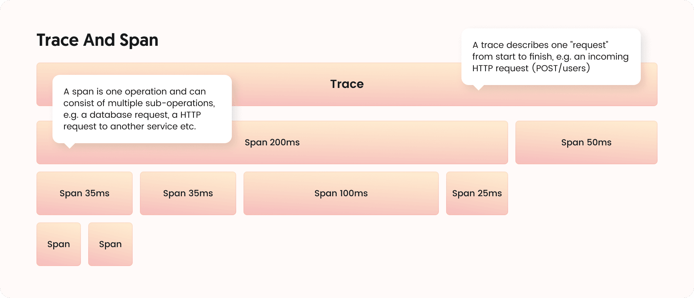
Tracing and Spans

Slide 37
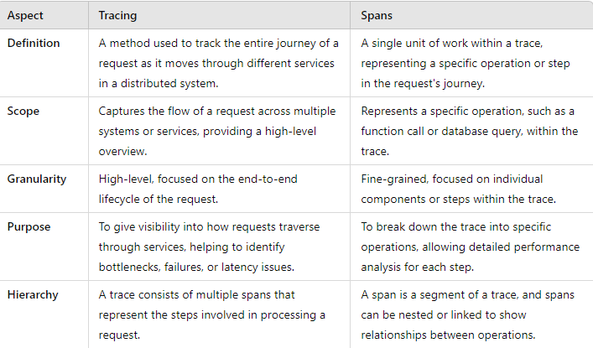
Tracing and Spans

Slide 38
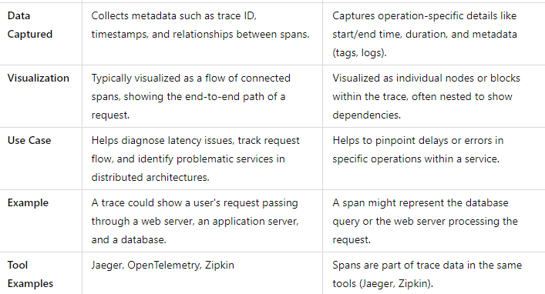
Tracing and Spans

Slide 39
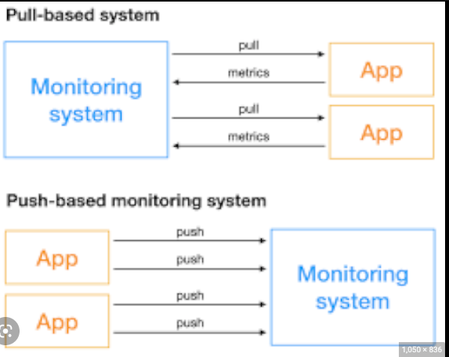
Push vs Pull

Slide 40
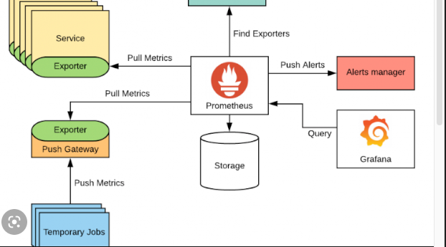
Push vs Pull

Slide 41
Push vs Pull
Pull Model (Prometheus's Native Model)
In the pull model, Prometheus regularly scrapes metrics from targets (services, servers, or applications) at specified intervals.
It pulls metrics data by sending HTTP requests to a predefined endpoint (usually /metrics).
How it works:
Prometheus server queries the /metrics endpoint of each target.
The target exposes metrics in a specific format that Prometheus understands.
Prometheus pulls data at intervals specified in its configuration.

Slide 42
Push vs Pull
Advantages:
Prometheus can control the frequency of data collection.
It can handle a dynamic list of targets and retry if one fails to respond.
Easier to monitor targets behind load balancers since Prometheus pulls from the available endpoint.
The target can remain stateless as it doesn’t need to track which systems want its metrics.

Slide 43
Push vs Pull
Disadvantages:
May not work well for short-lived jobs, as these may disappear before Prometheus scrapes their metrics.
Not ideal for environments where network access from Prometheus to the target is restricted.

Slide 44
Push vs Pull
Push Model (Not Native to Prometheus but Achievable)
The push model involves the target sending (pushing) its metrics to a central location.
Prometheus does not natively support a push mechanism, but the Pushgateway component fills this gap.
The Pushgateway acts as an intermediary that receives metrics from applications (especially short-lived jobs) and exposes them to Prometheus.

Slide 45
Push vs Pull
How it works:
Targets push their metrics to a Push gateway.
The Push gateway exposes a /metrics endpoint for Prometheus to scrape the pushed data.
The Push gateway stores the metrics until Prometheus pulls them.

Slide 46
Push vs Pull
Advantages:
Suitable for short-lived jobs (e.g., batch jobs or CI jobs) that might finish execution before Prometheus can scrape them.
Can work in environments where the network setup restricts Prometheus from pulling metrics directly from targets (e.g., firewalls, private networks).
Useful when the target cannot keep an HTTP server running to expose metrics continuously.

Slide 47
Push vs Pull
Disadvantages:
Introduces an extra component (Push gateway), which adds complexity.
The state of the Push gateway must be managed, as it retains data until explicitly deleted.
Push gateway is not designed for continuous metrics (e.g., long-lived services); it's primarily intended for short-lived jobs.

Slide 48
Service Discovery
Service discovery is a key concept in microservices and distributed systems.
It refers to the process of automatically detecting and connecting microservices in a network.
In these environments, services communicate with each other, and their locations (IP addresses, ports) may change dynamically due to scaling, failures, or deployments.
Service discovery helps maintain seamless communication between services despite these changes.

Slide 49
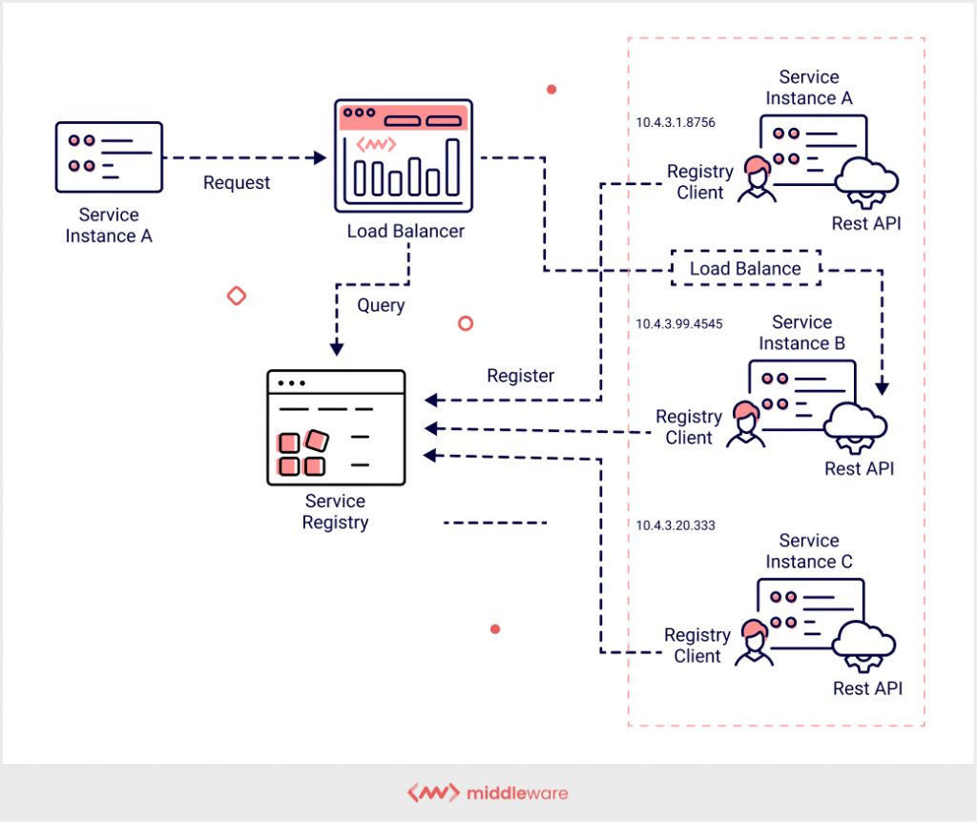
Service Discovery

Slide 50
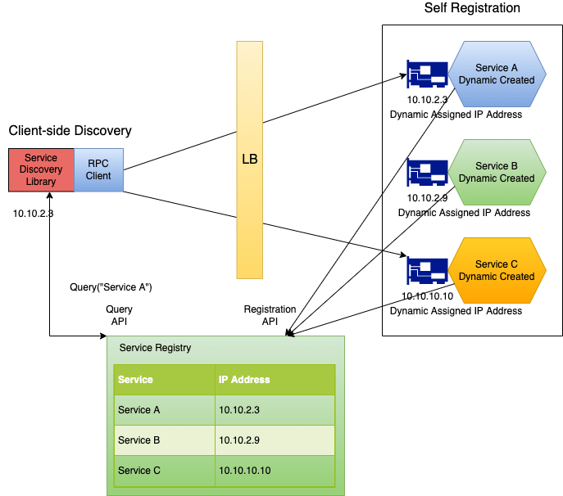
Service Discovery

Slide 51
Service Discovery
1. Client-side discovery:
In client-side discovery, the client (the service that wants to make a request) is responsible for determining the location of service instances.
A service registry contains the addresses of all available services.
The client queries the registry to find a valid service instance and then sends a request directly to the selected instance.

Slide 52
Service Discovery
Components:
Service Registry: A centralized database that tracks all instances of services.
Client: The service that queries the service registry and selects a service instance.
Examples:
Netflix Eureka (client-side service discovery)
Consul (can be used for client-side)

Slide 53
Service Discovery
Server-side discovery:
In server-side discovery, the client sends a request to a load balancer, which in turn queries the service registry and forwards the request to an appropriate service instance.
The client is unaware of where the actual service instance is located; it simply sends the request to the load balancer.

Slide 54
Service Discovery
Components:
Service Registry: Stores the locations of services.
Load Balancer/Service Proxy: Acts as an intermediary between the client and service instances.
Examples:
AWS Elastic Load Balancing (ELB)
Kubernetes (through the use of DNS or environment variables)

Slide 55
Service Discovery
Common Technologies for Service Discovery:
Eureka: A service discovery tool developed by Netflix for client-side discovery.
Consul: A service mesh and service discovery tool from HashiCorp that supports both client-side and server-side discovery.
Kubernetes: Uses internal DNS or environment variables for service discovery within a cluster.
Zookeeper: Often used with Apache frameworks for service discovery.

Slide 56
Service Discovery
How it Works:
Service Registration: When a new service instance starts, it registers itself with the service registry, providing details like IP address, port, and metadata.
Service Deregistration: When a service instance stops, it deregisters itself from the registry to avoid sending traffic to unavailable instances.
Health Checks: The registry may periodically perform health checks to ensure that the registered services are available and healthy.

Slide 57
Service Discovery
Benefits of Service Discovery:
Scalability: Helps services find and communicate with each other dynamically, supporting high levels of scaling.
Resilience: Allows systems to adapt to changes in the environment, such as instances going down or new ones being added.
Flexibility: Can support different deployment environments (cloud, containers, on-premises).

Slide 58
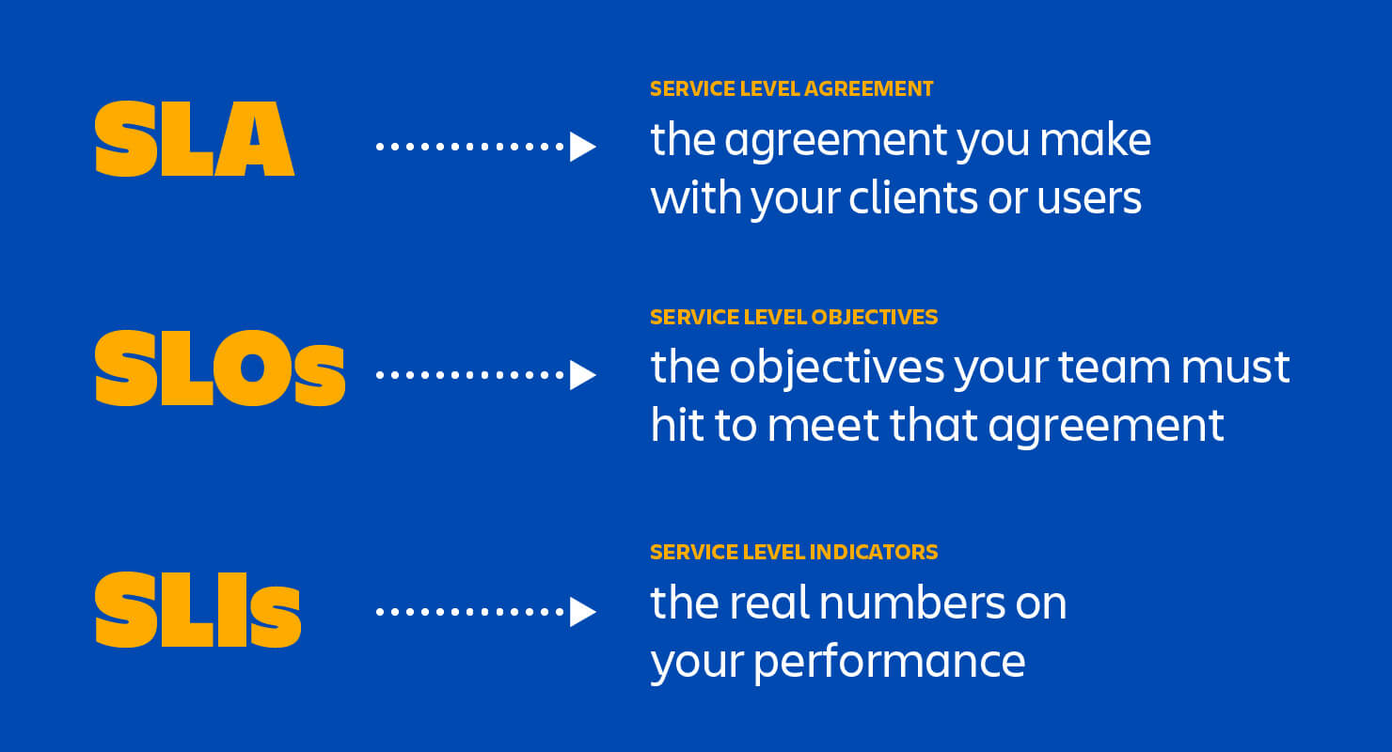
SLA vs SLO vs SLI

Slide 59
Basics of SLOs, SLAs, and SLIs
SLA (Service Level Agreement):
An SLA is a formal agreement between a service provider and a customer.
It defines the specific measurable service performance standards that the provider is obligated to meet.
SLAs are typically legally binding and include consequences (such as penalties or service credits) if the service provider fails to meet the agreed-upon standards.

Slide 60
Basics of SLOs, SLAs, and SLIs
Key Points:
Purpose: Sets expectations for service performance and outlines responsibilities between the provider and customer.
Enforceability: Often legally binding with penalties for non-compliance.
Example: "The service provider guarantees 99.9% uptime over a month. If this is not met, the customer will receive a 5% refund of the monthly service fee."

Slide 61
Basics of SLOs, SLAs, and SLIs
SLO (Service Level Objective):
An SLO is a specific, measurable goal that defines the acceptable performance level of a service.
SLOs are part of the SLA but are less formal than the SLA itself.
They act as internal targets for the service provider, helping to ensure that the SLAs are met.
The SLO is used to define performance objectives like availability, latency, or response times.

Slide 62
Basics of SLOs, SLAs, and SLIs
Key Points:
Purpose: Sets measurable objectives that help the service provider track and maintain service levels.
Measurable: Clearly defined metrics such as uptime percentage, error rates, or latency thresholds.
Example: "The system should have an uptime of 99.9% each month."

Slide 63
Basics of SLOs, SLAs, and SLIs
SLI (Service Level Indicator):
An SLI is the actual measurement or metric that indicates how well a service is performing against the SLOs.
SLIs are quantitative measurements, typically expressed as percentages or time units, that track specific characteristics of a service (such as availability, latency, throughput, or error rate).
SLIs provide the data that allows a provider to understand whether they are meeting their SLOs and SLAs.

Slide 64
Basics of SLOs, SLAs, and SLIs
Key Points:
Purpose: Provides real-time metrics or measurements of service performance.
Monitoring: Often collected through monitoring tools and compared against SLOs.
Example: "The service achieved 99.95% uptime last month" (where uptime is the SLI).

Slide 65
Open Telemetry
Open Telemetry (OTel) is an open-source observability framework that provides tools, APIs, and SDKs for collecting metrics, logs, and traces from applications.
It's a unified standard for instrumenting your software to monitor performance and diagnose issues.
Backed by CNCF (Cloud Native Computing Foundation)
Combines the efforts of OpenTracing and OpenCensus.

Slide 66
Open Telemetry
a. Telemetry Data Types
Traces: Represent the flow of requests through systems (Distributed Tracing).
Metrics: Numeric values measured over time (e.g., CPU usage, request count).
Logs: Textual records of events.
b. Signals
Each telemetry data type is considered a signal.
OTel supports multi-signal collection.

Slide 67
Open Telemetry Components
a. SDKs & APIs
Language-specific SDKs for Java, Python, Go, C#, etc.
Used for manual instrumentation or auto-instrumentation.
b. OpenTelemetry Collector
A vendor-agnostic agent that receives, processes, and exports telemetry data.
Supports receivers, processors, exporters.
Can transform, filter, or batch telemetry data.
Can run as an agent (on host) or gateway (centralized).

Slide 68
Open Telemetry Components
a. SDKs & APIs
Language-specific SDKs for Java, Python, Go, C#, etc.
Used for manual instrumentation or auto-instrumentation.
b. OpenTelemetry Collector
A vendor-agnostic agent that receives, processes, and exports telemetry data.
Supports receivers, processors, exporters.
Can transform, filter, or batch telemetry data.
Can run as an agent (on host) or gateway (centralized).

Slide 69
Open Telemetry Components
c. Exporters
Send telemetry data to backends like:
Jaeger, Zipkin (for traces)
Prometheus, Grafana Mimir (for metrics)
ElasticSearch, Splunk, Datadog, etc.

Slide 70
Open Telemetry Collector
The Open Telemetry Collector is a vendor-agnostic service designed to receive, process, and export telemetry data like traces, metrics, and logs from applications and infrastructure.
It's a key component in observability pipelines.

Slide 71
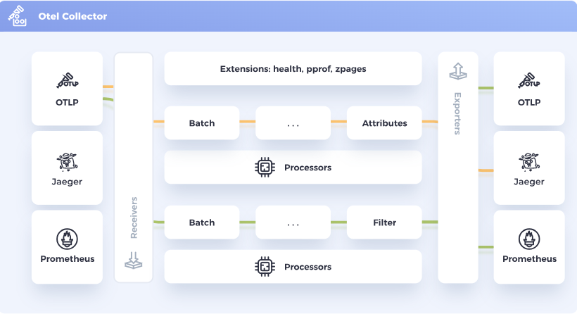
Open Telemetry Collector

Slide 72
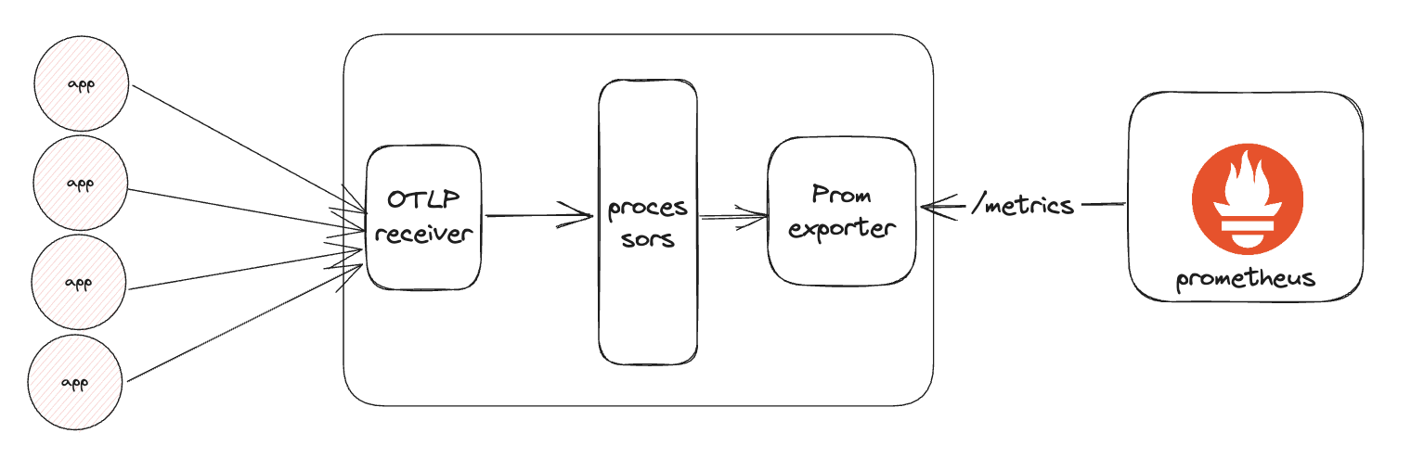
Open Telemetry Collector

Slide 73
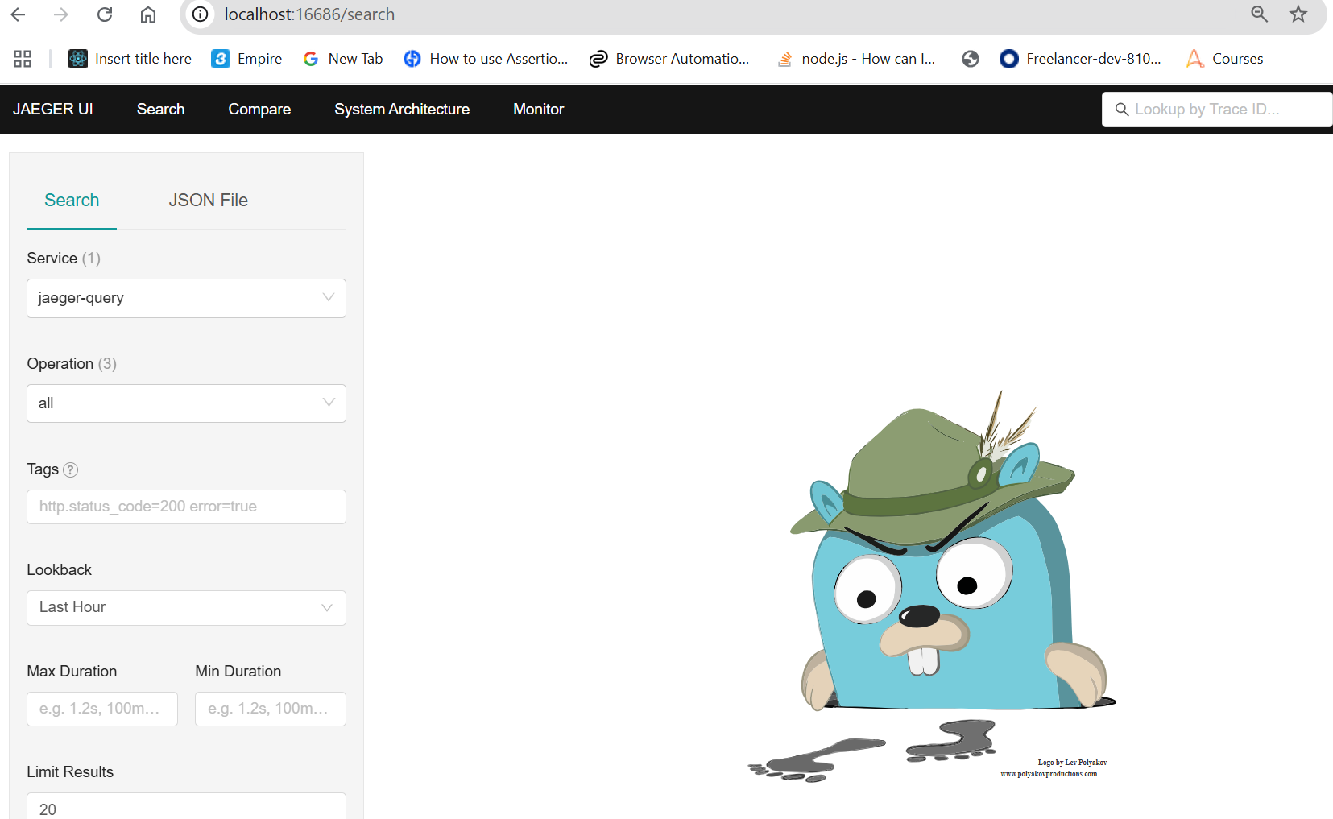
Open Telemetry Collector

Slide 74
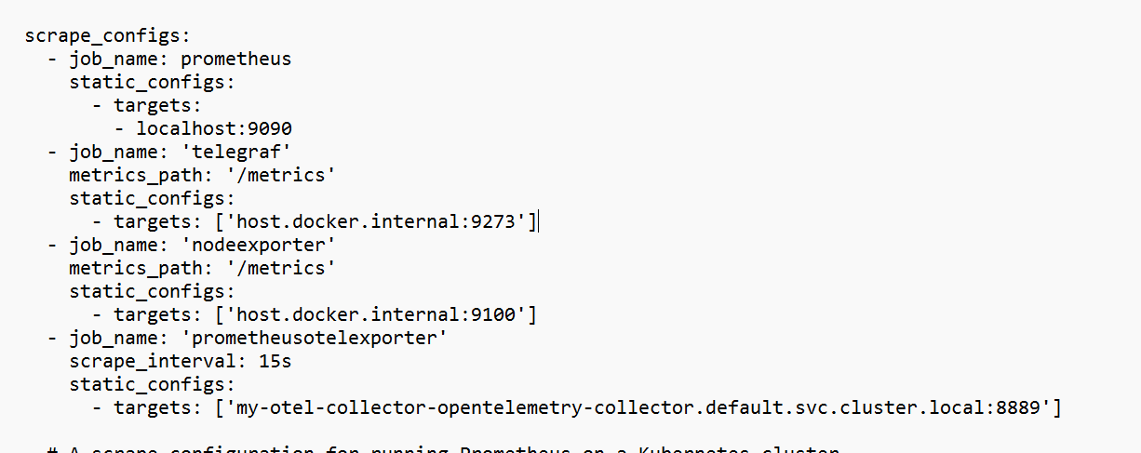
Open Telemetry Collector

Slide 75
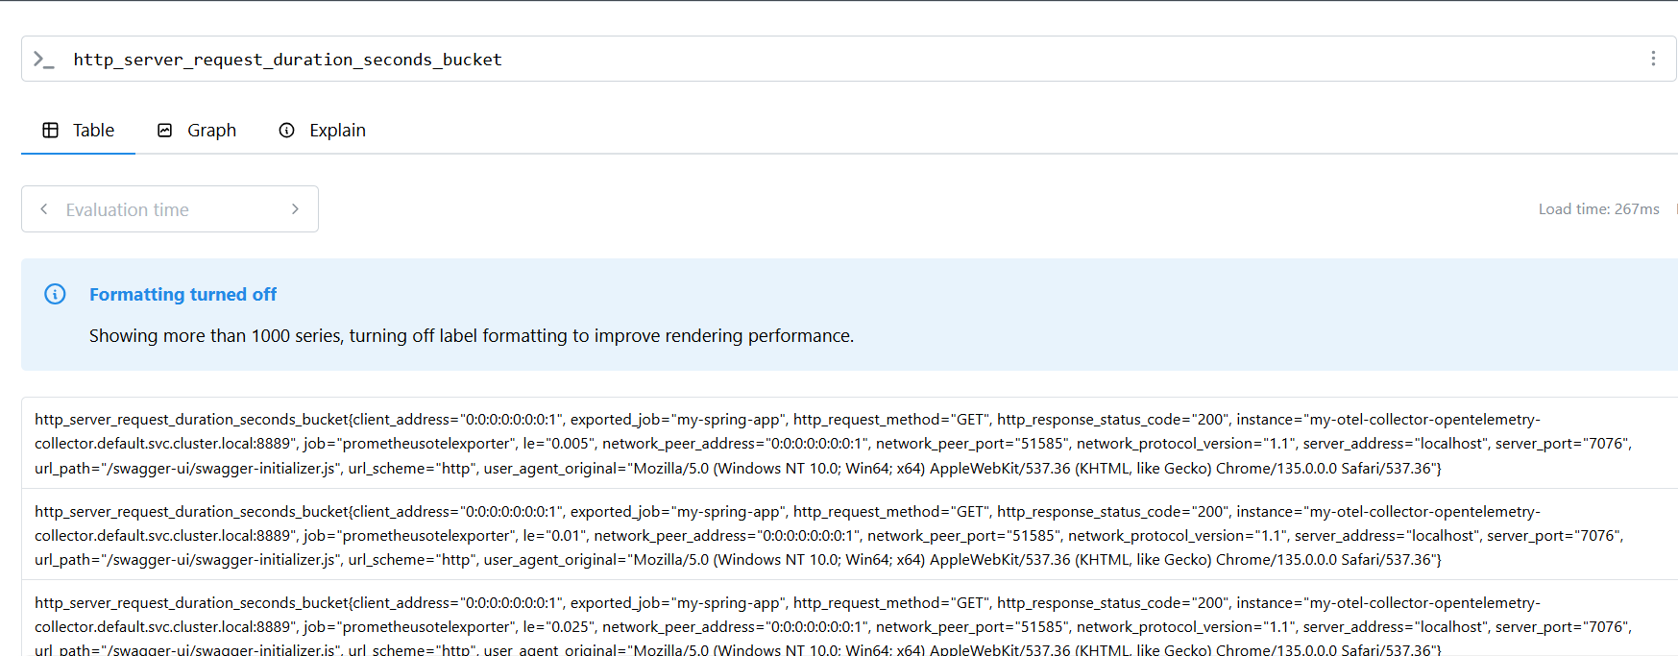
Open Telemetry Collector

Slide 76
Open Telemetry Collector
Objectives
Usability: Reasonable default configuration, supports popular protocols, runs and collects out of the box.
Performance: Highly stable and performant under varying loads and configurations.
Observability: An exemplar of an observable service.
Extensibility: Customizable without touching the core code.
Unification: Single codebase, deployable as an agent or collector with support for traces, metrics, and logs.

Slide 77
Open Telemetry Collector
Key Features:
Receives Data:
Supports OTLP, Jaeger, Prometheus, Zipkin, FluentBit, etc.
Handles metrics, traces, and logs.
Processes Data:
Add attributes, filter, batch, transform telemetry.
Supports pipelines with processors (e.g., sampling, filtering, batch).
Exports Data:
To backend systems like Prometheus, Grafana Mimir, Jaeger, Datadog, New Relic, Elasticsearch, etc.
Extensible:
You can add custom receivers, processors, or exporters.
Distributions like otel-contrib include community-contributed components.

Slide 78
Open Telemetry Collector
Core Components:
Receivers: Ingest telemetry data.
Processors: Modify/enrich telemetry.
Exporters: Send telemetry to observability platforms.
Extensions: Support services like health checks, pprof, zpages.

Slide 79
Open Telemetry Collector
Collector Modes:
Agent: Runs as a sidecar or on the host; close to the app.
Gateway: Runs as a central service; receives from multiple agents or apps.

Slide 80
Open Telemetry Collector
Common Use Cases:
Collect traces from microservices and export to Jaeger.
Collect metrics from applications and export to Prometheus.
Process logs and send them to Elasticsearch.

Slide 81
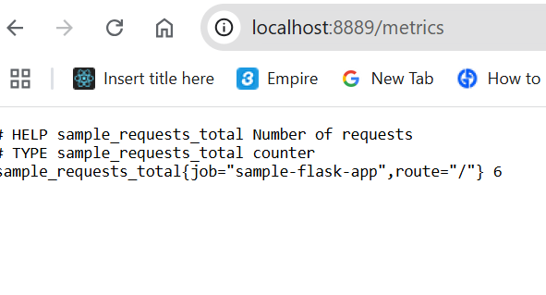
Open Telemetry Collector

Slide 82
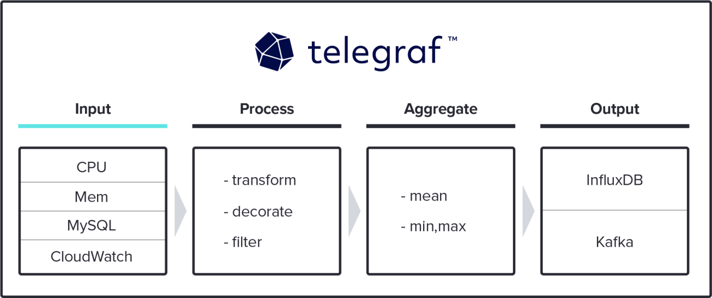
Installing Telegraf

Slide 83
Telegraf
Inputs: Pulls or receives metrics/logs from many sources:
System (CPU, memory, disk, network)
Applications (MySQL, PostgreSQL, Kafka, Redis, etc.)
Cloud providers (AWS CloudWatch, Azure Monitor, GCP Stackdriver)
Prometheus exporters (/metrics endpoints, remote_write)
IoT devices, SNMP, MQTT brokers, etc.

Slide 84
Telegraf
Processors: Can enrich, filter, or transform metrics before sending.
Example: Drop certain labels, rename fields, or calculate new values.
Aggregators: Do on-agent rollups before shipping (avg, min, max).
Outputs: Sends data to destinations such as:
InfluxDB (v1 or v2)
Prometheus remote_write
Kafka, MQTT, NATS
Graphite, OpenTSDB, Datadog, Elastic, etc.

Slide 85
Why It’s Useful
Single lightweight agent instead of many custom collectors.
Pluggable: over 300 input/output plugins.
Low resource use (written in Go, tiny footprint).
Decouples collection from storage → you can forward the same metrics to multiple systems.
Kubernetes-friendly: often run as a DaemonSet to scrape node/pod metrics and ship to InfluxDB/Prometheus.

Slide 86
Telegraf
Key Features:
Plugins: 300+ input, output, and processor plugins.
Input Sources: System stats, logs, databases, services (Docker, Kubernetes).
Output Options: InfluxDB, Prometheus, Kafka, OpenTelemetry.
Lightweight & Efficient: Suitable for edge and server environments.

Slide 87
Telegraf
Use Case:
Collect system-level metrics (CPU, memory, disk, network).
Send custom metrics to monitoring backends.
Acts as a bridge between services and monitoring tools.

Slide 88
Grafana Mimir
Overview:
Grafana Mimir is a highly scalable, long-term storage backend for Prometheus metrics, optimized for large-scale environments.

Slide 89
Grafana Mimir
Key Features:
Horizontal Scalability: Handle massive amounts of Prometheus metrics.
Multi-Tenancy: Supports isolated metric storage for different users/teams.
High Availability: Supports sharding and replication.
Integration: Works seamlessly with Grafana for visualization.

Slide 90
Grafana Mimir
Use Case:
Store and query time-series metrics for long-term analysis.
Backend for Prometheus setups needing high availability and scalability.
Centralized metric storage across multiple Prometheus instances.

Slide 91
Integration Workflow Example
Instrumentation:
Use OpenTelemetry SDK in applications to capture traces and metrics.
Use Telegraf to gather system-level metrics.
Data Collection:
Send telemetry data to OpenTelemetry Collector.
Telegraf sends metrics directly to Prometheus or OTel Collector.
Storage:
OpenTelemetry Collector exports metrics to Prometheus Remote Write or Grafana Mimir.
Telegraf can also push to Mimir (via Prometheus output plugin).
Visualization:
Grafana reads from Mimir to visualize metrics and traces.

Slide 92
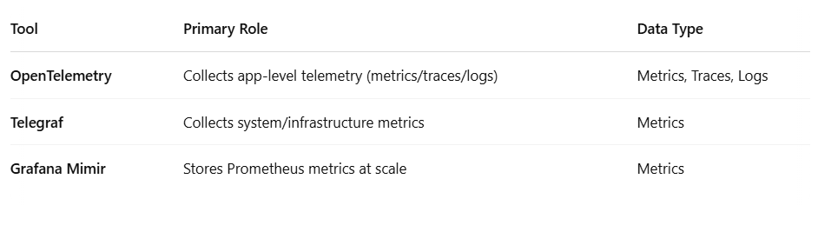
Comparison of Roles

Slide 93
Real-World Scenario Example
Microservice App:
Uses Open Telemetry to generate traces and metrics.
Host Server:
Runs Telegraf to collect CPU, memory, and disk metrics.
Both push data to Open Telemetry Collector.
Collector exports data to Grafana Mimir.
Metrics and traces are visualized in Grafana Dashboards.

Slide 94
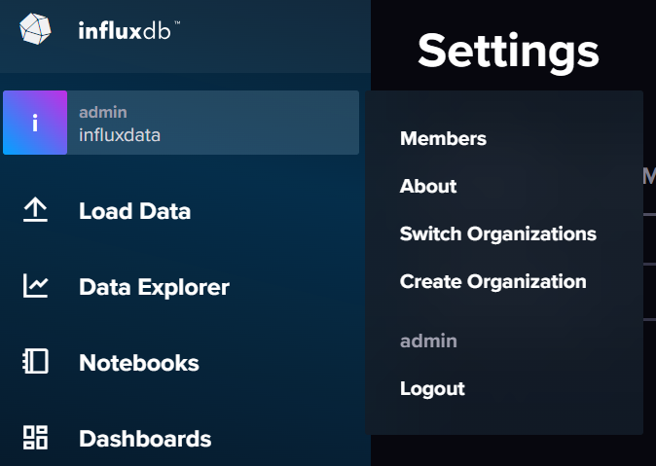

Grafana Influx DB Connection

Slide 95
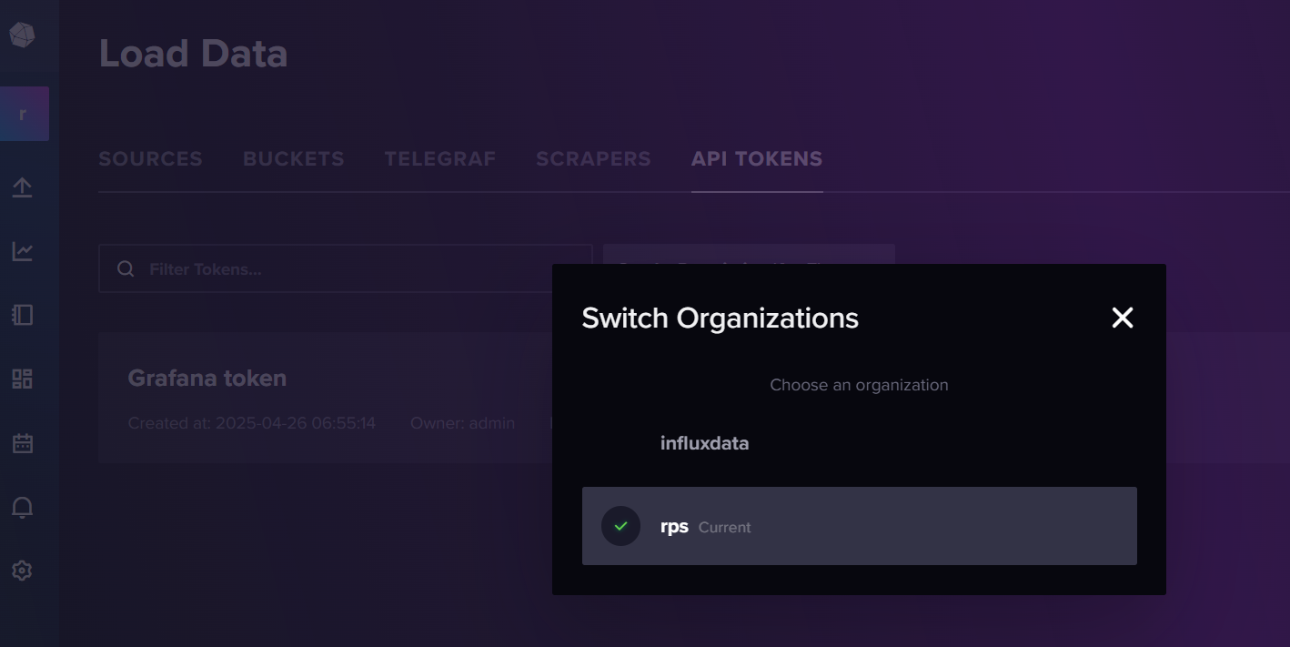
Grafana Influx DB Connection

Slide 96
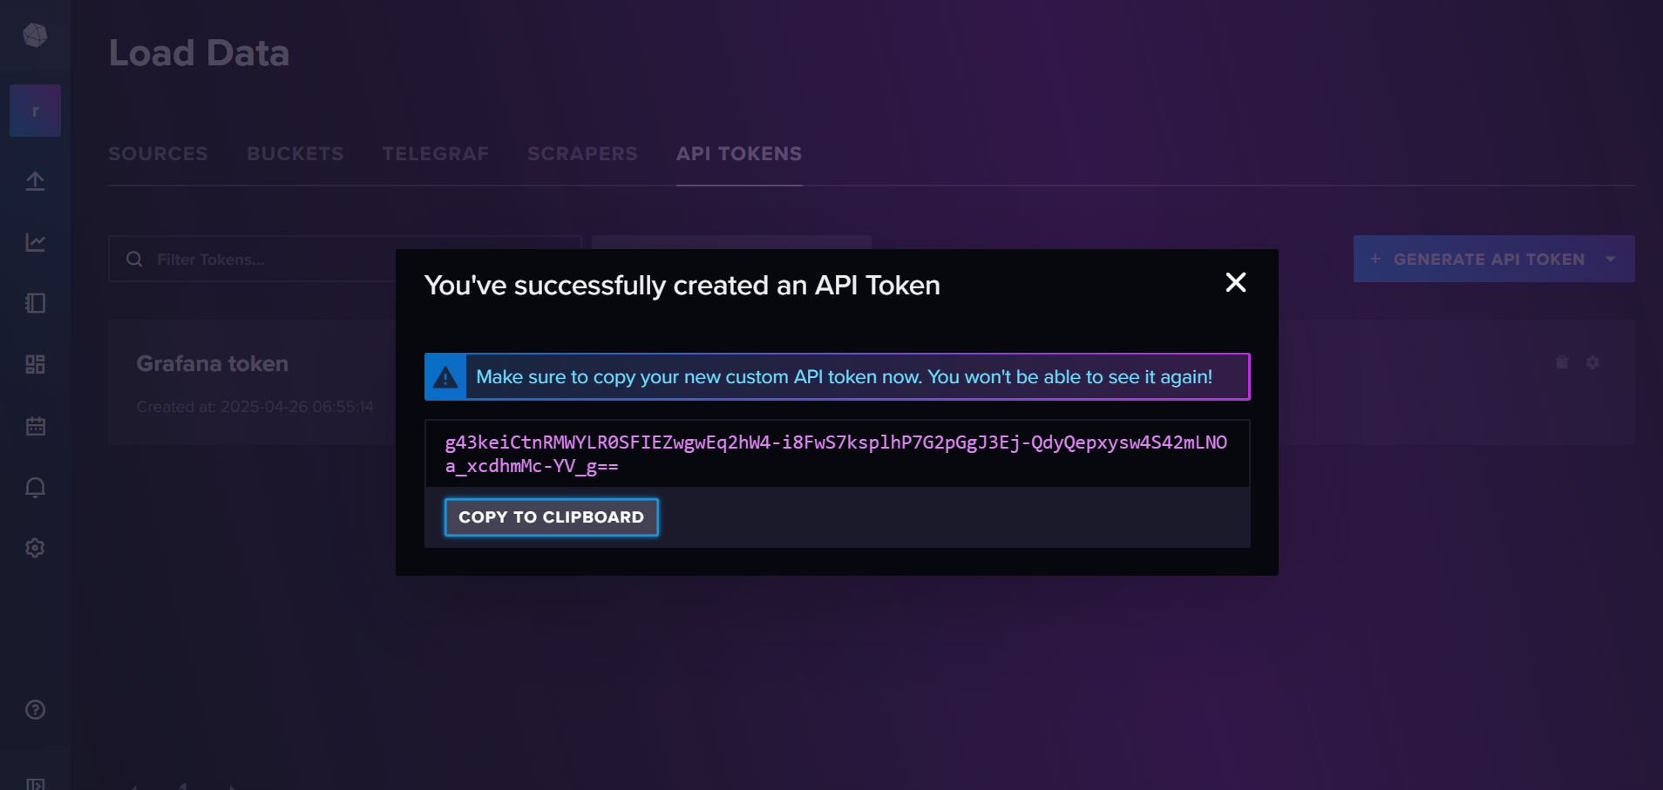
Grafana Influx DB Connection

Slide 97
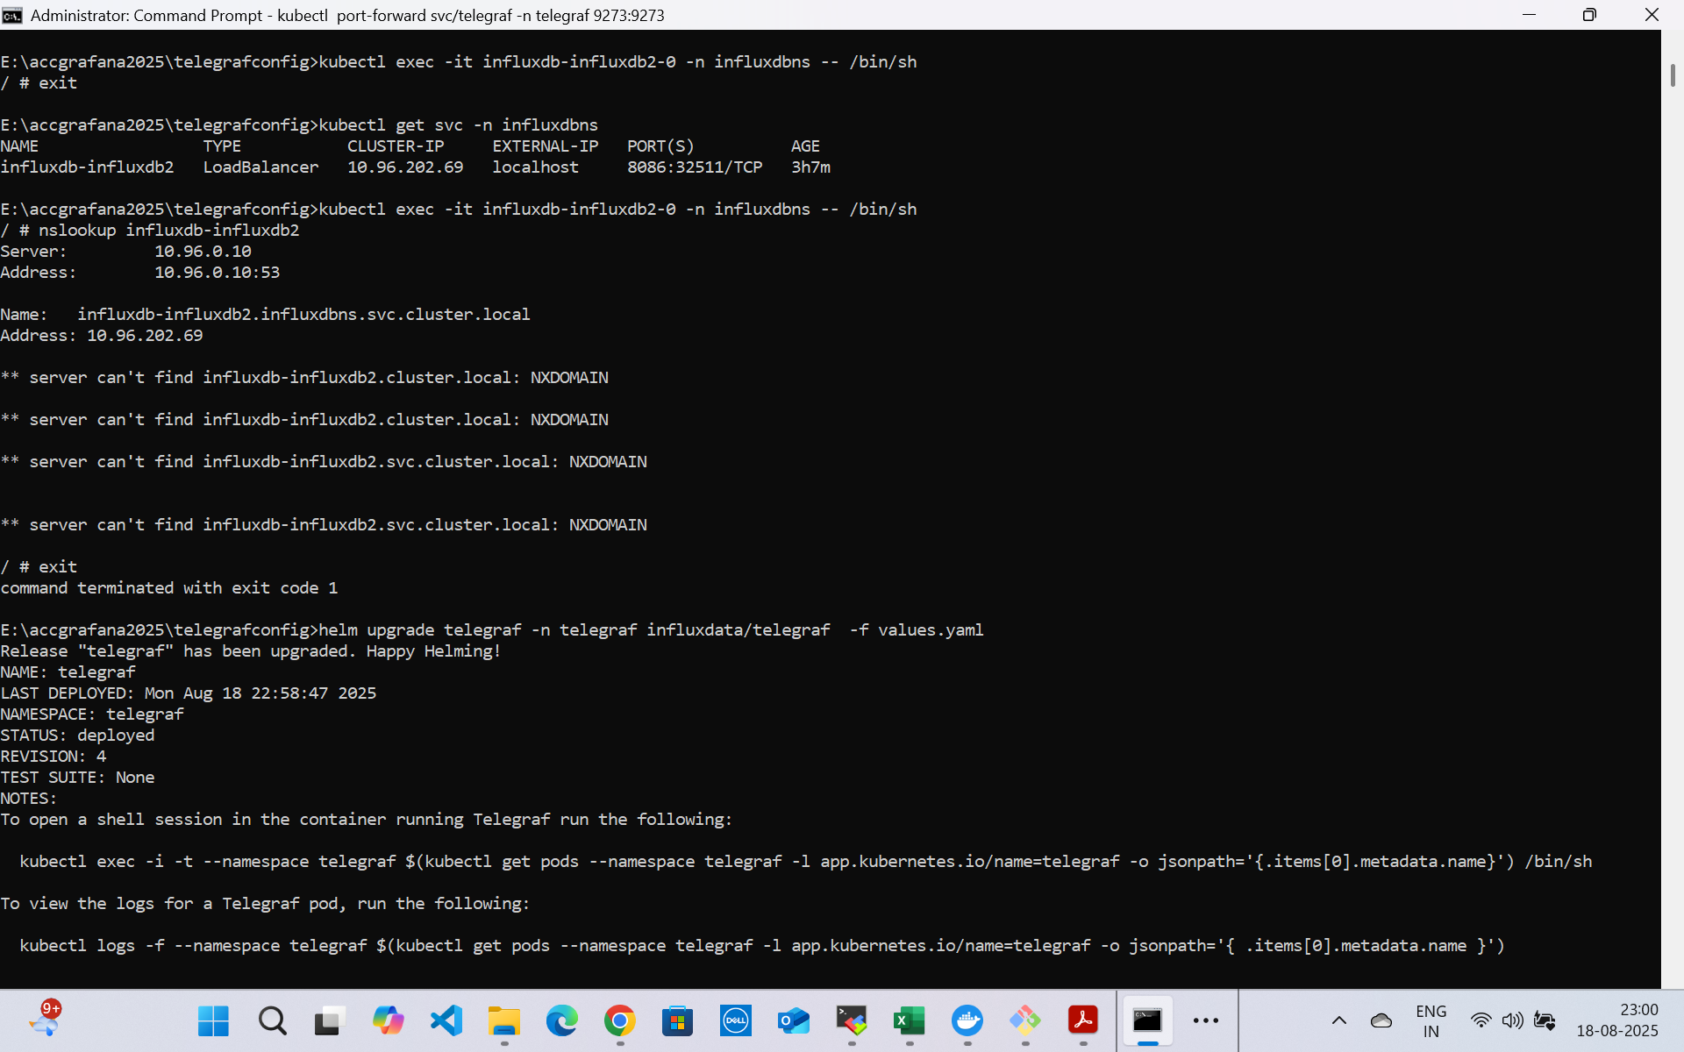
Grafana Influx DB Connection

Slide 98
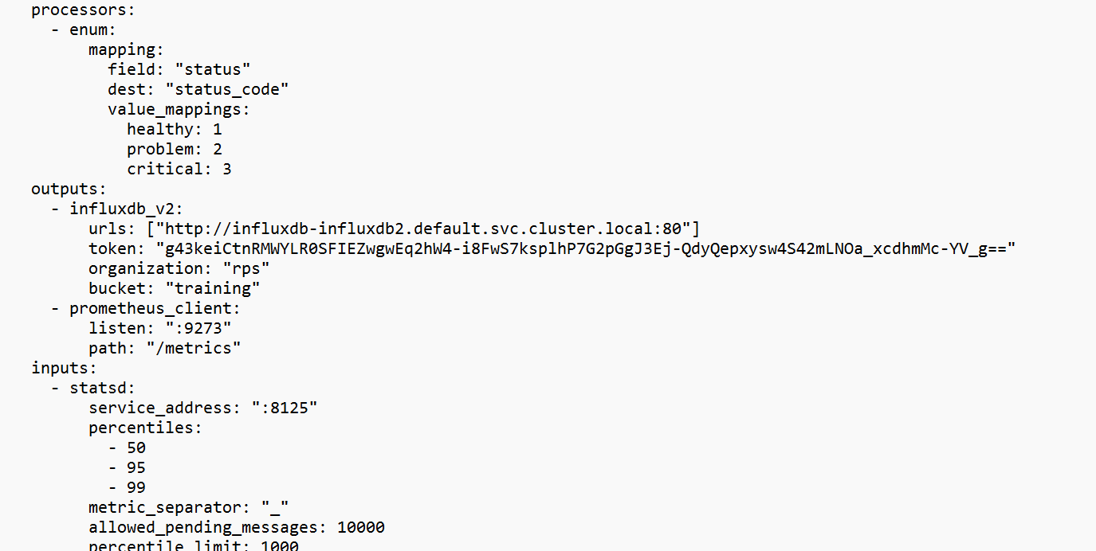

Grafana Influx DB Connection

Slide 99
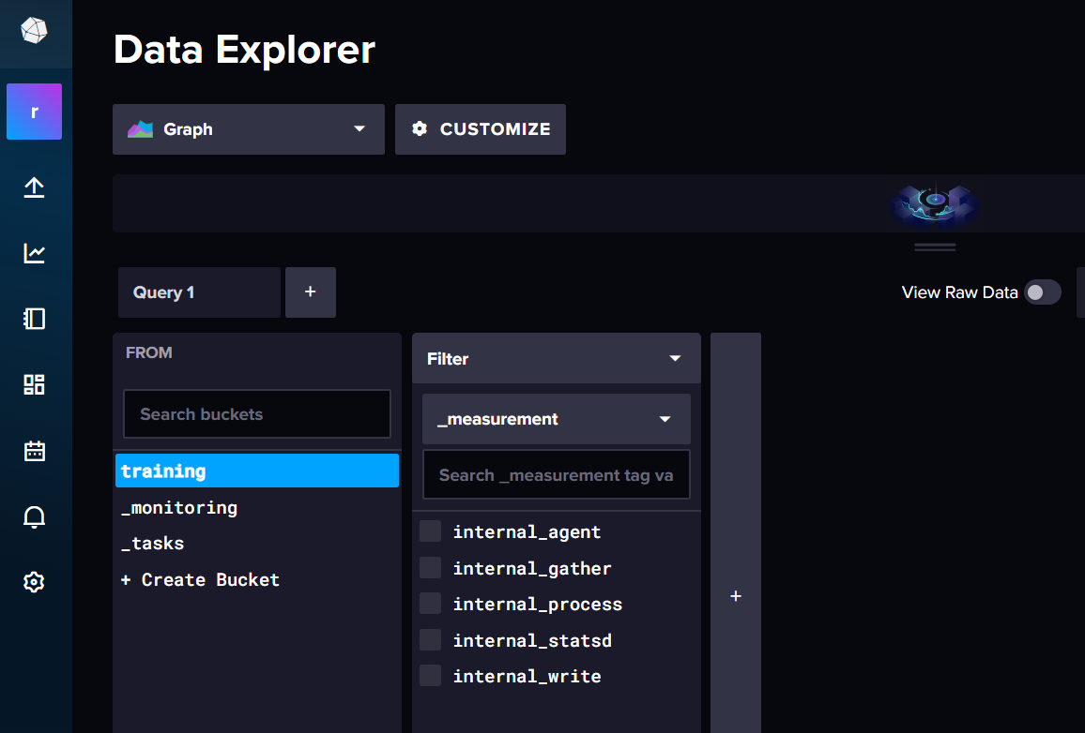
Grafana Influx DB Connection

Slide 100
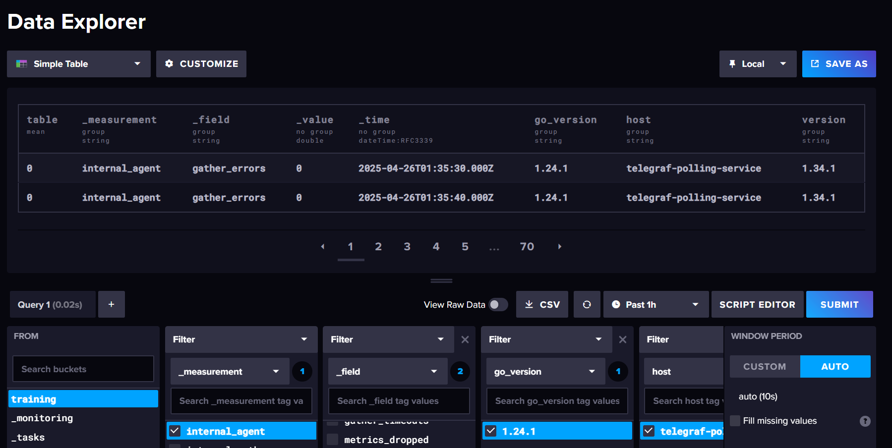
Grafana Influx DB Connection

Slide 101
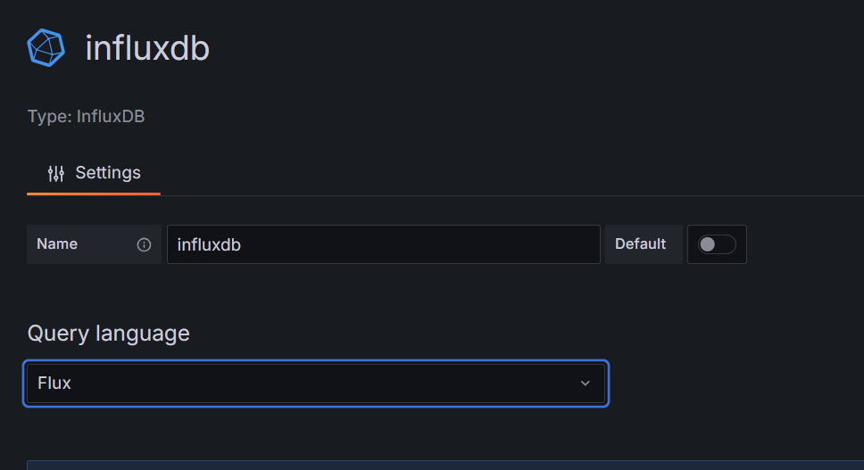


Grafana Influx DB Connection

Slide 102
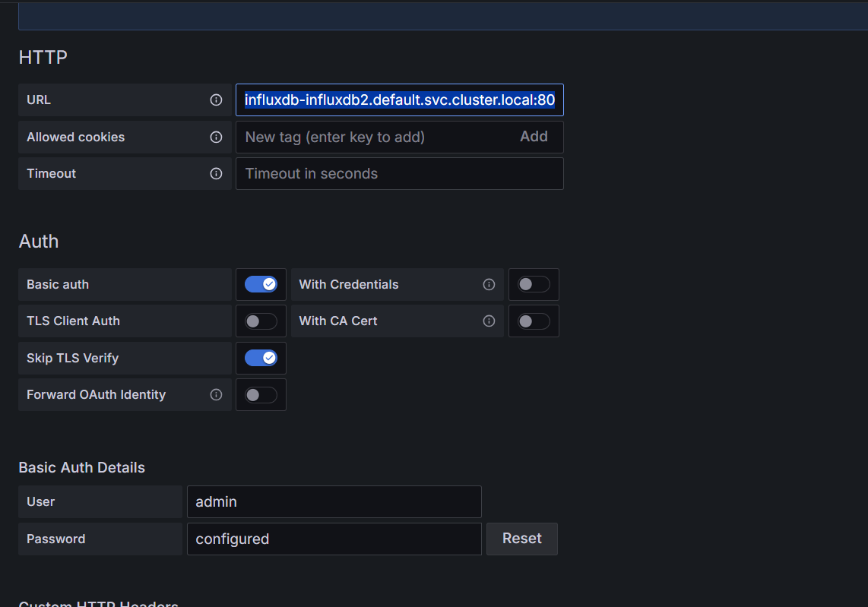

Grafana Influx DB Connection

Slide 103
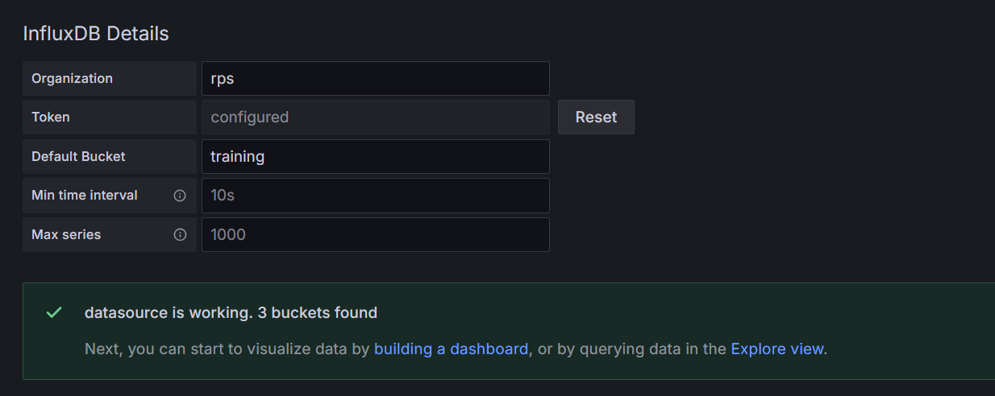

Grafana Influx DB Connection
Generated token influx db

Slide 104
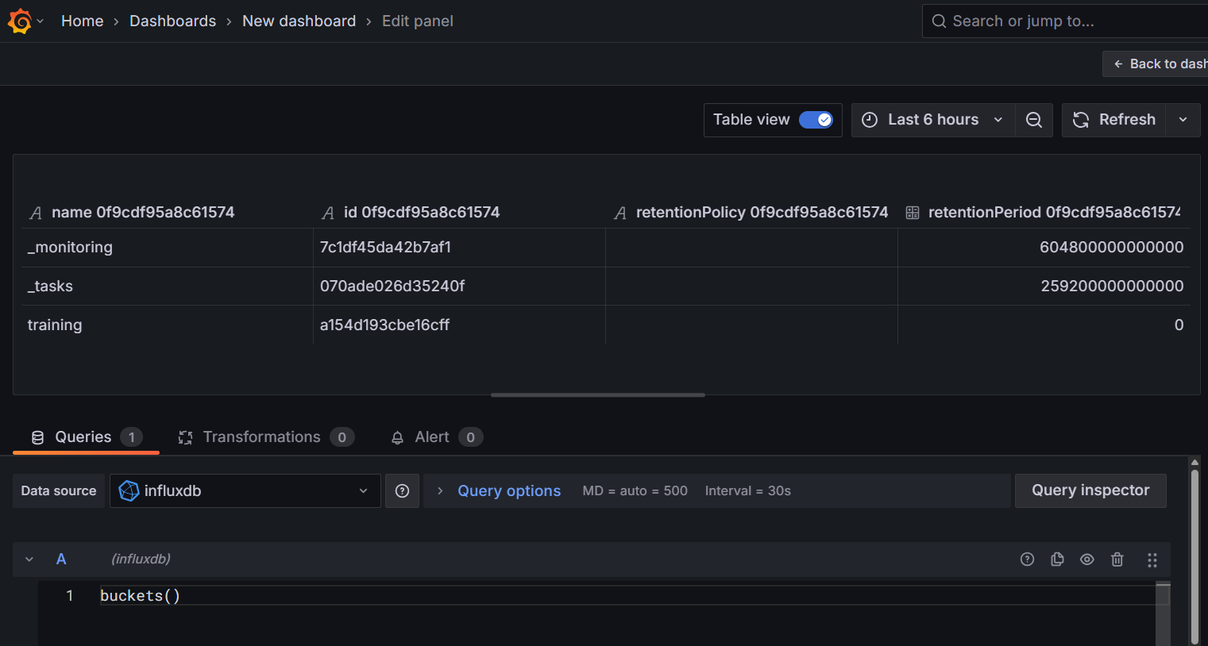
Grafana Influx DB Dashboard

Slide 105
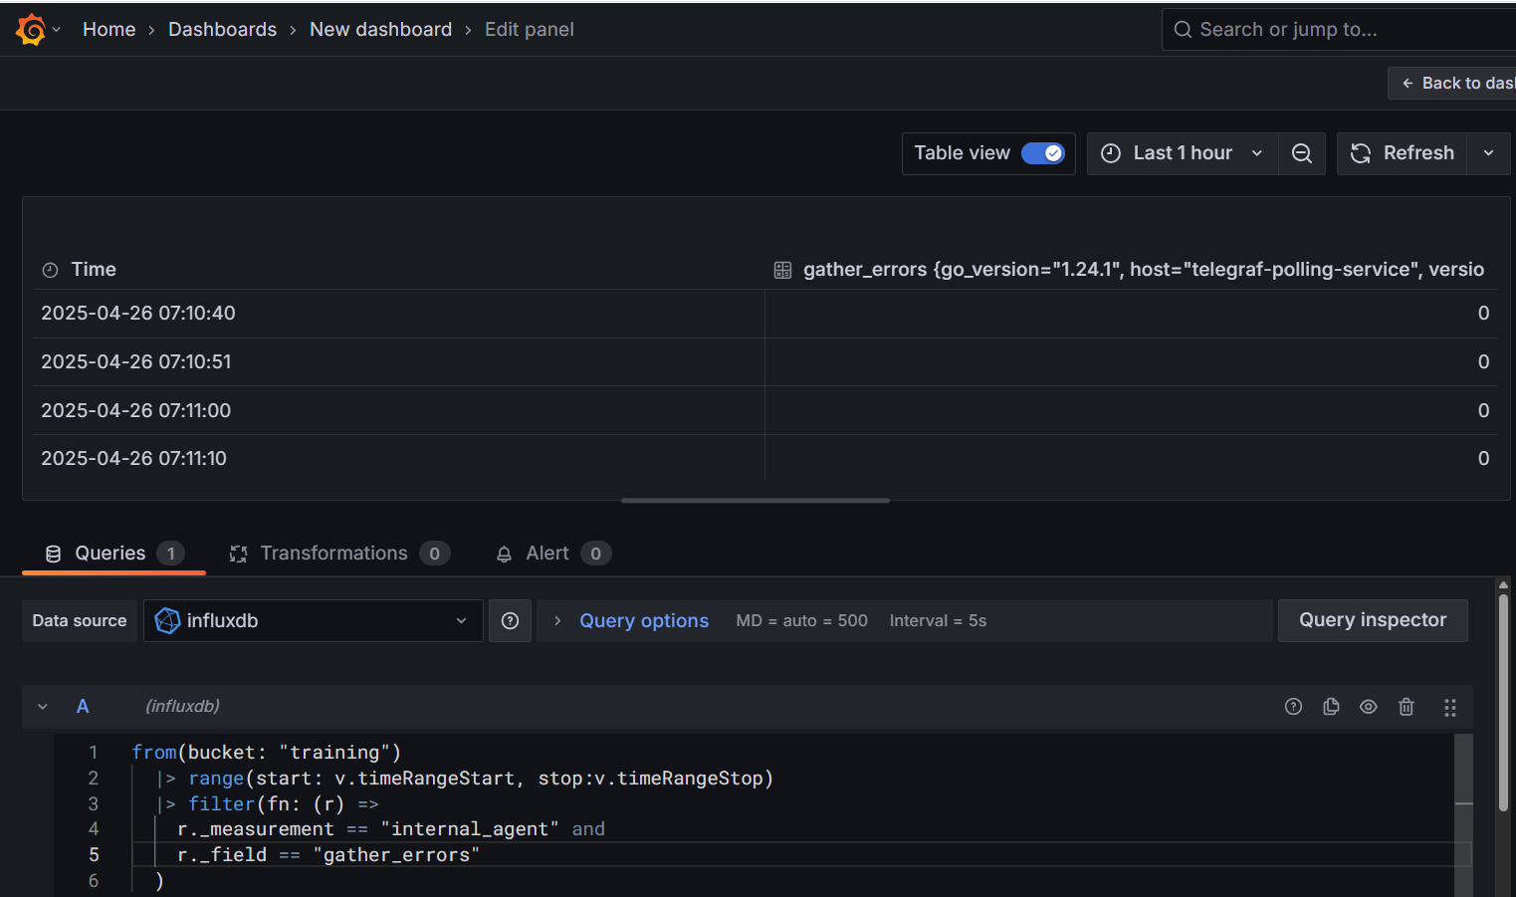
Grafana Influx DB Dashboard

Slide 106
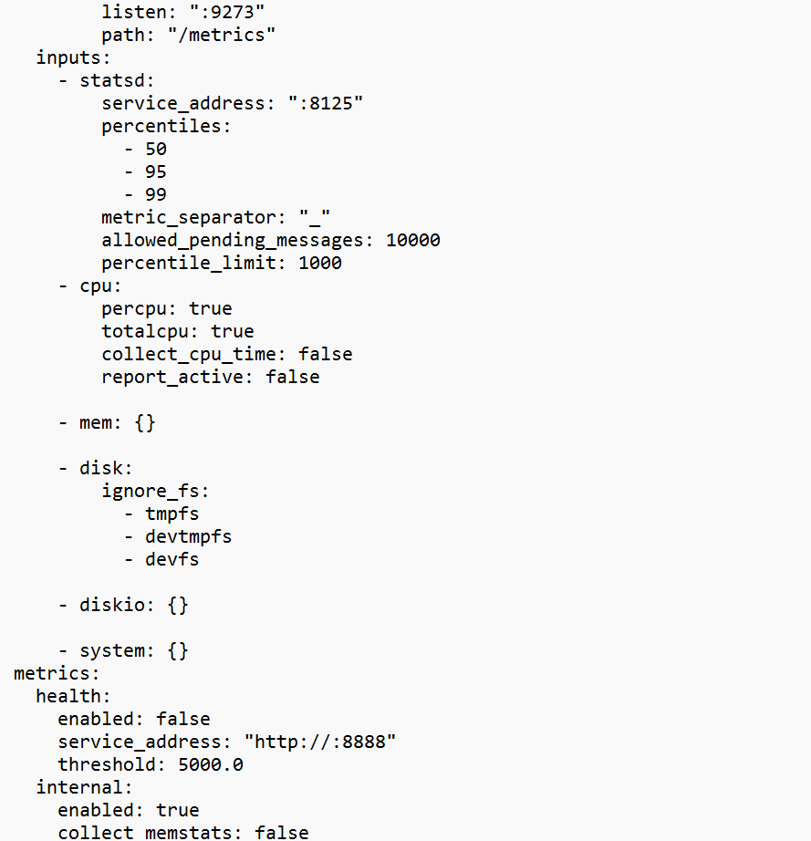

Telegraf Input Configuration

Slide 107
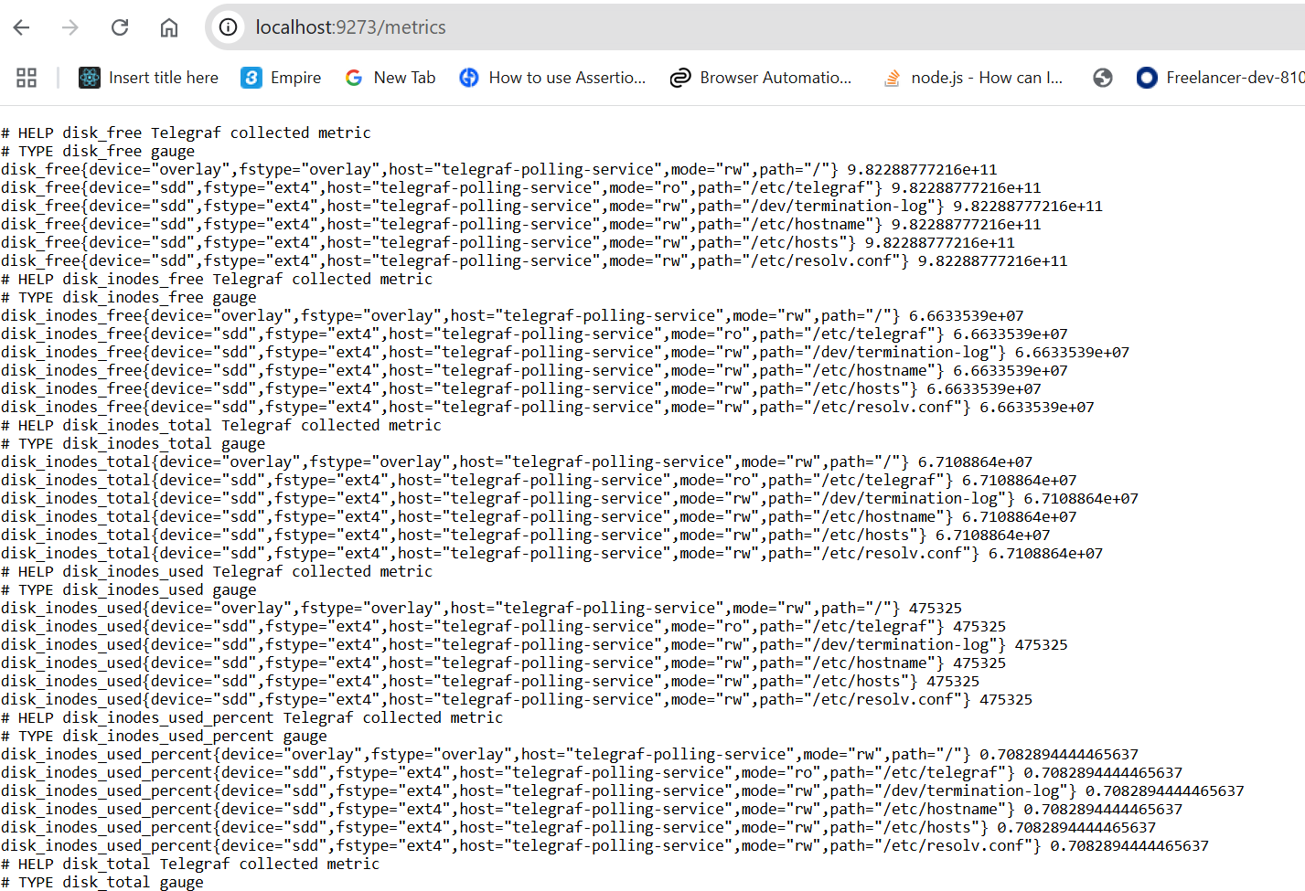
Telegraf Input Configuration

Slide 108
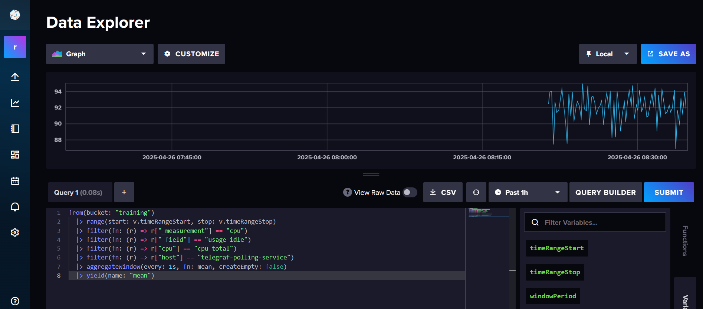
Telegraf Input Configuration

Slide 109
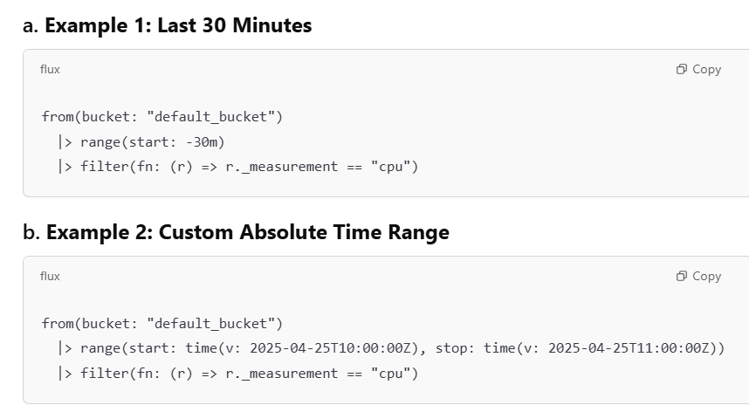
Telegraf Input Configuration

Slide 110
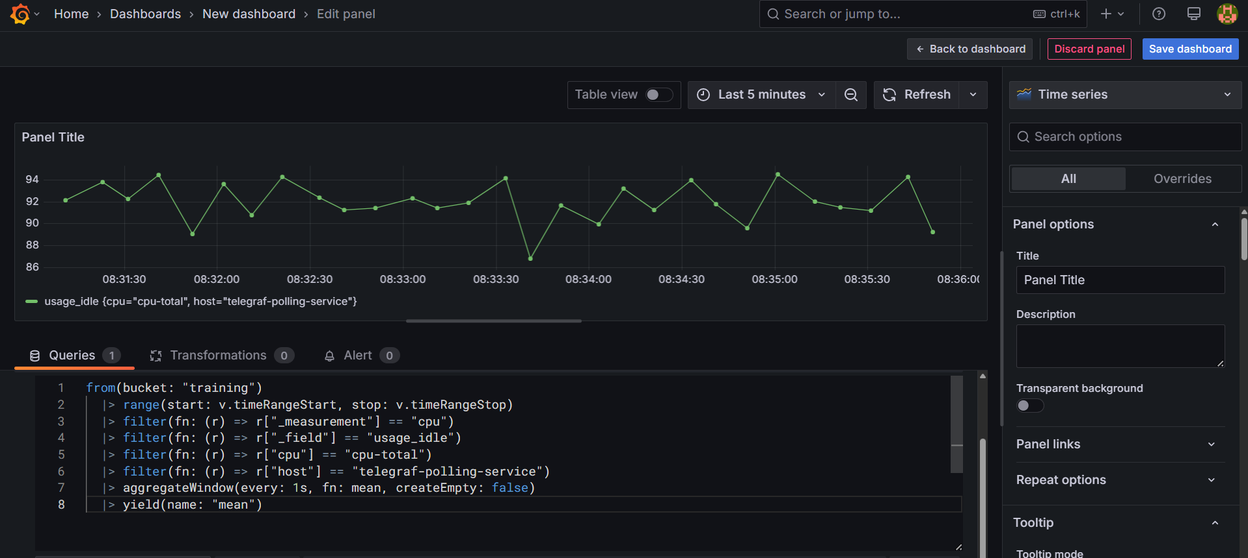
Grafana Dashboard

Slide 111
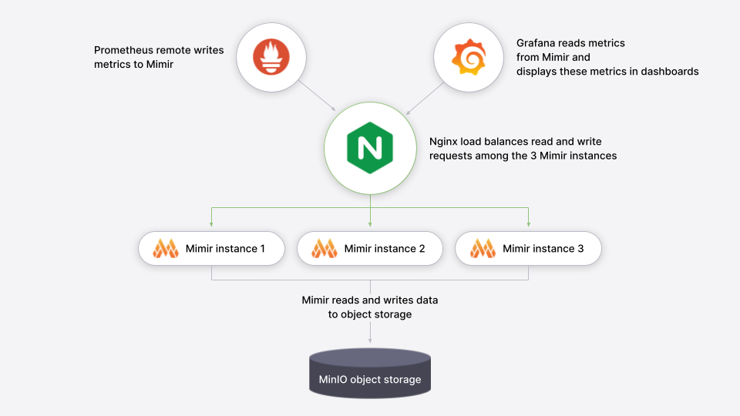

Mimir

Slide 112
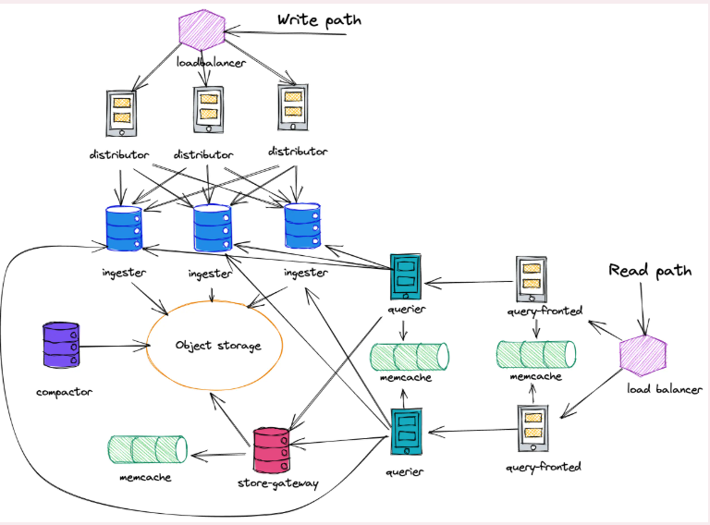
Mimir

Slide 113
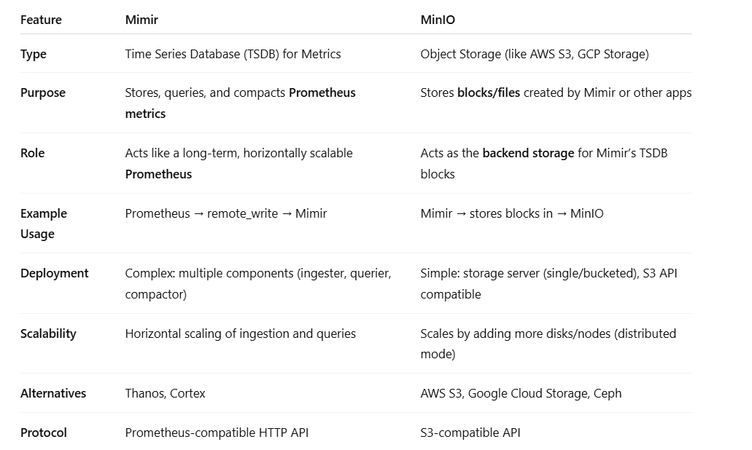
Mimir vs Minio

Slide 114
Mimir Installation
helm install mimir grafana/mimir-distributed -f values.yaml
kubectl get secret mimir-minio -o jsonpath="{.data.rootUser}" | base64 --decode
grafana-user
kubectl get secret mimir-minio -o jsonpath="{.data.rootPassword}" | base64 --decode
supersecret
kubectl port-forward svc/mimir-minio-console 9001:9001
kubectl port-forward svc/mimir-minio 9000:9000

Slide 115
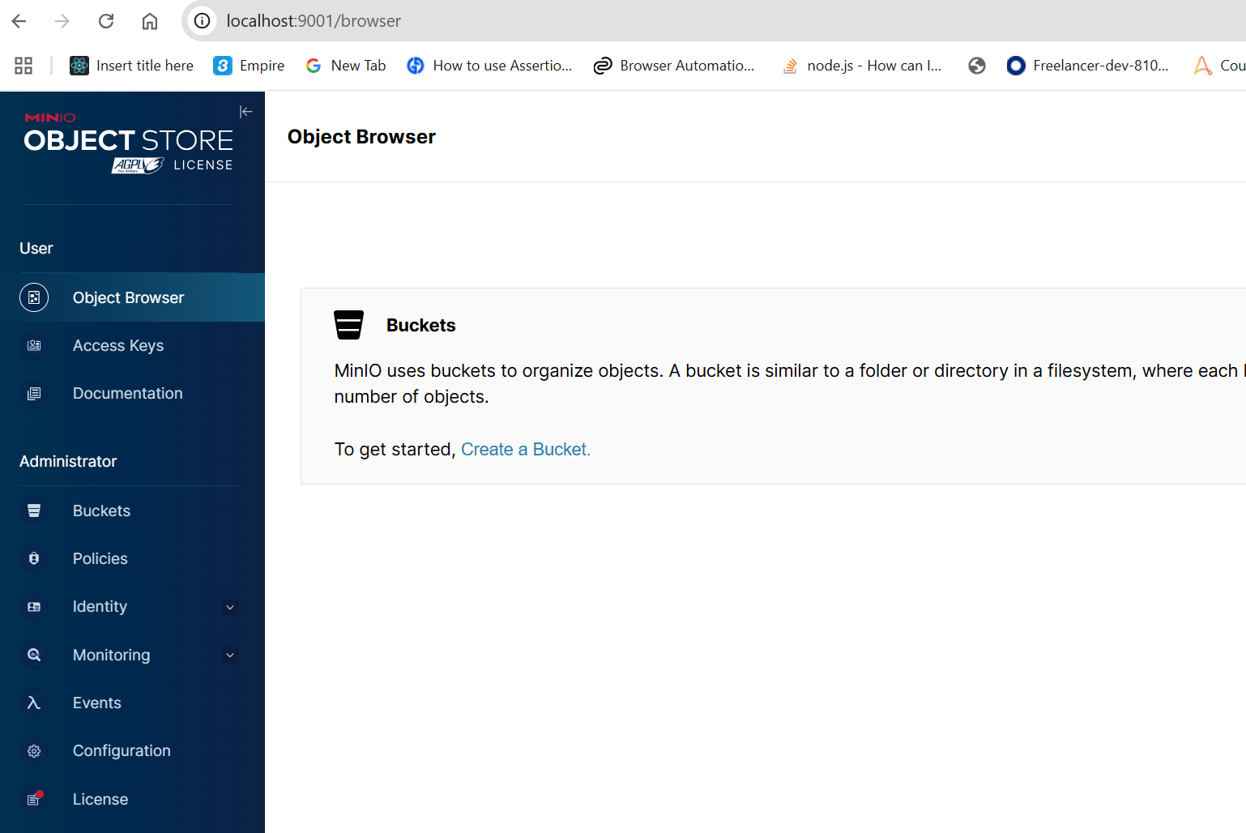
Mimir Installation

Slide 116
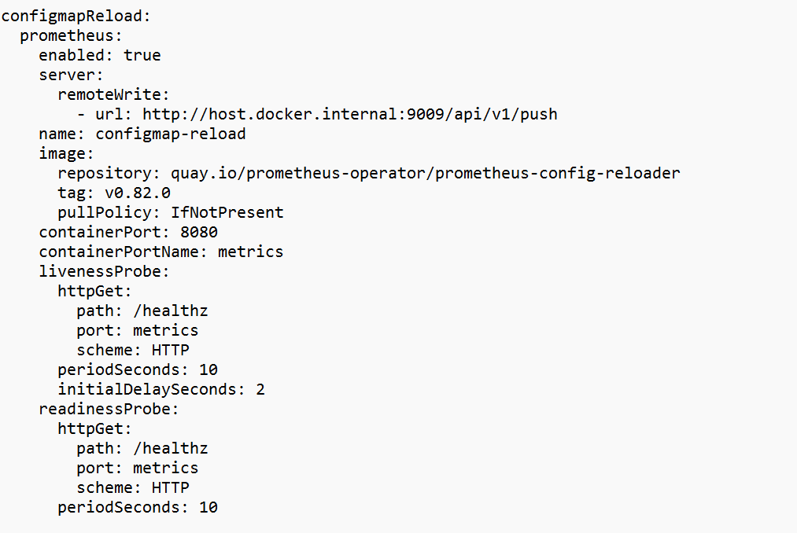
Mimir Installation

Slide 117
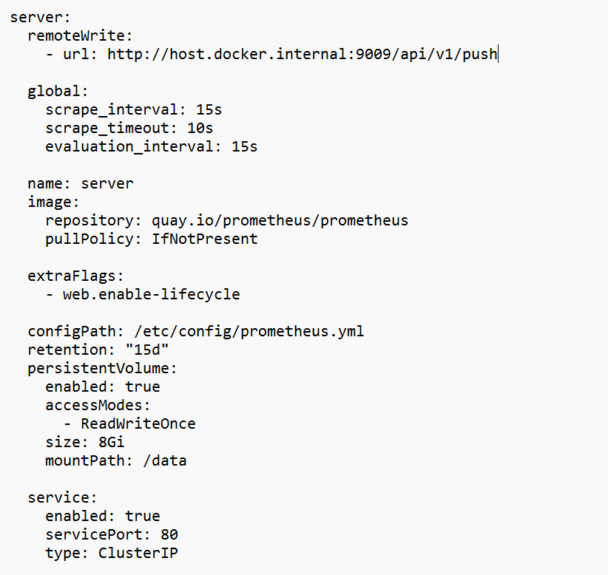
Mimir Installation

Slide 118


Mimir Installation

Slide 119

Mimir Installation

Slide 120

Mimir Grafana

Slide 121

Mimir Grafana

Slide 122

Metrics Sent from Prometheus to Mimir

Slide 123
Prometheus fundamentals

Slide 124
Prometheus
Prometheus is an open-source technology designed to provide monitoring and alerting functionality for cloud-native environments, including Kubernetes.
It can collect and store metrics as time-series data, recording information with a timestamp.
It can also collect and record labels, which are optional key-value pairs.

Slide 125
Prometheus Features
Multidimensional data model – Using time-series data, which is identified by metric name and key-value pairs.
PromQL – A flexible querying language that can leverage the multi-dimensional data model.
No reliance on distributed storage – All single server nodes remain autonomous.
Pull model – Prometheus can collect time-series data by actively “pulling” data over HTTP.
Pushing time-series data – Available through the use of an intermediary gateway.
Monitoring target discovery – Available through static configuration or service discovery.
Visualization – Prometheus offers multiple types of graphs and dashboards.

Slide 126
Micrometer Prometheus
Micrometer provides a simple facade over the instrumentation clients for the most popular monitoring systems.
It allows us to instrument JVM-based application code without vendor lock-in.
Micrometer is an open-source project and provides a metric facade that exposes metric data in a vendor-neutral format that a monitoring system can understand.

Slide 127
Monitoring Systems
These monitoring systems are supported:
AppOptics
Azure Monitor
Netflix Atlas
CloudWatch
Datadog
Dynatrace
Elastic
Ganglia
Graphite
Humio
Influx/Telegraf
JMX
KairosDB
New Relic
Prometheus
SignalFx
Google Stackdriver
StatsD
Wavefront

Slide 128
How Does Prometheus Monitoring Work?
To get metrics, Prometheus requires an exposed HTTP endpoint.
Once an endpoint is available, Prometheus can start scraping numerical data, capture it as a time series, and store it in a local database suited to time-series data.
Prometheus can also be integrated with remote storage repositories.

Slide 129
How Does Prometheus Monitoring Work?
Users can leverage queries to create temporary times series from the source.
These series are defined by metric names and labels.
Queries are written in PromQL, a unique language that allows users to choose and aggregate time-series data in real time.
PromQL can also help us establish alert conditions, resulting in notifications to external systems like email, PagerDuty, or Slack.

Slide 130
How Does Prometheus Monitoring Work?
Prometheus can display collected data in tabular or graph form, shown in its web-based user interface.
We can also use APIs to integrate with third-party visualization solutions like Grafana.

Slide 131
What Can You Monitor with Prometheus?
Prometheus is a versatile monitoring tool, which you can use to monitor a variety of infrastructure and application metrics.
Use Cases
Service Metrics
Host Metrics
Website Uptime/Up Status
Cronjobs

Slide 132
Service Metrics
Prometheus is typically used to collect numeric metrics from services that run 24/7.
It allows metric data to be accessed via HTTP endpoints.
This can be done manually or with various client libraries.
Prometheus exposes data using a simple format, with a new line for each metric, separated with line feed characters.
The file is published on an HTTP server that Prometheus can query and scrape metrics from based on the specified path, port, and hostname.
Prometheus can also be used for distributed services, which are run on multiple hosts.
Each instance publishes its own metrics and has a name that Prometheus can distinguish.

Slide 133
Host Metrics
We can monitor the operating system to identify when a server’s hard disk is full or if a server operates constantly at 100% CPU.
We can install a special exporter on the host to collect the operating system information and publish it to an HTTP-reachable location.

Slide 134
Website Uptime/Up Status
Prometheus doesn’t usually monitor website status, but we can use a black box exporter to enable this.
We specify the target URL to query an endpoint.
It performs an uptime check to receive information such as the website’s response time.
We define the hosts to be queried in the prometheus.yml configuration file, using relabel_configs to ensure Prometheus uses the black box exporter.

Slide 135
Cronjobs
To check if a cronjob is running at the specified intervals, we can use the Push Gateway to display metrics to Prometheus through an HTTP endpoint.
We can push the timestamp of the last successful job (i.e. a backup job) to the Gateway and compare it with the current time in Prometheus.
If the time exceeds the specified threshold, the monitor times out and triggers an alert.

Slide 136
Prometheus Metric Types
The client libraries of Prometheus offer three core types of metrics.
However, the Prometheus server does not currently save these metrics as different data types.
Instead, it flattens all information into an untyped time series.

Slide 137
Prometheus Metric Types
Counter
This is a cumulative metric. It represents a single monotonically-increasing counter, and its value can either increase or be reset to zero on restart.
Gauge
This metric represents one numerical value, which can arbitrarily go down and up.
A gauge is often used to measure values like current memory usage or temperatures.
Histogram
A histogram samples observations, such as request durations or response sizes.
It then counts the observations in a configurable bucket.
A histogram can also provide a total sum of all the observed values.

Slide 138
Prometheus Architecture
Prometheus follows a pull-based model where it scrapes metrics from monitored targets at specified intervals.
It uses a multi-dimensional data model for storing time-series data and provides a flexible query language called PromQL to retrieve and analyze this data.
Prometheus is a standalone service that doesn’t require external storage.

Slide 139
Prometheus Architecture
Key Components of Prometheus Architecture:
Prometheus Server:
The Prometheus server is at the core of the system architecture. It is responsible for:
Data Collection: Scraping metrics from target services at defined intervals.
Data Storage: Storing scraped time-series data in a local time-series database (TSDB).
Querying: Processing queries written in PromQL to retrieve and analyze the collected data.

Slide 140
Prometheus Architecture
Targets (Instrumented Services):
Targets are the systems and applications being monitored by Prometheus.
These targets expose metrics via an HTTP endpoint (typically /metrics), which Prometheus scrapes.
Prometheus interacts with these services by pulling metrics from them at regular intervals.
Targets can be instrumented applications, exporters, or third-party systems like databases or cloud services.

Slide 141
Prometheus Architecture
Exporters:
Exporters are specialized services that expose metrics from third-party systems or non-instrumented services in a Prometheus-compatible format.
Common exporters:
Node Exporter: Exposes system-level metrics (CPU, memory, disk, etc.).
Blackbox Exporter: Probes endpoints (HTTP, DNS, ICMP) to check for uptime and reachability.
Database Exporters (e.g., MySQL, PostgreSQL): Export database-specific metrics.

Slide 142
Prometheus Architecture
Service Discovery:
Prometheus supports dynamic service discovery, which allows it to automatically find and scrape targets in dynamic environments (e.g., cloud, Kubernetes).
It supports a variety of service discovery mechanisms:
Kubernetes
Consul
EC2 instances
DNS-based discovery
Service discovery helps in automatically adapting to infrastructure changes, such as when services scale up or down.

Slide 143
Prometheus Architecture
Time-Series Database (TSDB):
Prometheus stores all metrics as time-series data, identified by a unique metric name and label set.
The time-series data is stored locally on disk and compressed to optimize space.
Data is kept for a configurable retention period, after which it is deleted.

Slide 144
Prometheus Architecture
Alert manager:
Alert manager handles alerts generated by Prometheus when a rule condition is met (e.g., high CPU usage).
Prometheus evaluates alerting rules against the data and pushes alerts to the Alertmanager.
Alert manager’s Role:
Alert Deduplication: Prevents repeated alerts for the same issue.
Grouping: Groups related alerts to reduce noise.
Routing: Sends alerts to the appropriate receiver (email, Slack, PagerDuty, etc.).
Silencing: Temporarily suppresses alerts during planned maintenance.

Slide 145
Prometheus Architecture
Prometheus Client Libraries:
Prometheus provides client libraries for different programming languages (Go, Python, Java, Ruby, etc.) to enable custom metrics instrumentation in applications.
Developers can use these libraries to instrument their code and expose custom application-specific metrics.

Slide 146
Prometheus Architecture
PromQL (Prometheus Query Language):
Prometheus comes with its own powerful query language, PromQL, which allows users to select and aggregate time-series data.
PromQL supports complex operations like rate calculations, aggregations, and joins across metrics.

Slide 147
Prometheus Architecture
Pushgateway (Optional):
Prometheus uses a pull model, but sometimes systems may not be suited to be scraped (e.g., batch jobs or short-lived processes).
The Pushgateway allows these systems to push metrics to Prometheus. It acts as an intermediary for these metrics, storing them until Prometheus pulls them.

Slide 148

Prometheus Component Architecture

Slide 149
Prometheus Server
The Prometheus server handles the scraping and storing of metrics.
The server manages scheduling of monitoring jobs – querying data sources (called “instances”) at a predefined polling frequency.
Monitoring jobs are configured via one or more “scrape config” directives, managed via a YAML configuration file.
It can be live-reloaded using a SIGHUP or the Management API.

Slide 150
Prometheus Server
Prometheus relies heavily on various service discovery (SD) mechanisms to identify targets to scrape.
These service discovery integrations range from generic interfaces like a file-based service discovery that custom SD implementations can leverage by managing a JSON or YAML file containing a list of targets.

Slide 151
Prometheus Server
Prometheus also provides number of platform-specific SD implementations, including: Kubernetes, AWS EC2, Azure, GCE, Docker Swarm, OpenStack, and more.
These generally integrate with the corresponding APIs to query the platform for targets running applications and exporters that can be scraped by Prometheus.

Slide 152
Prometheus Data Flow
Scraping:
Prometheus scrapes metrics from the targets (applications, services, exporters) at a configured interval via HTTP. Each target exposes an endpoint that Prometheus polls for metrics.
Storing:
Scraped metrics are stored in Prometheus’s internal time-series database.
Each metric is stored as a time-series, identified by a combination of a metric name and key-value labels.
Example metric format:

Slide 153
Prometheus Data Flow
Querying:
Users or external systems (like dashboards) can query the stored time-series data using PromQL.
Queries can be used to retrieve data for monitoring, debugging, or performance analysis.
Alerting:
Prometheus evaluates alerting rules against the stored data at regular intervals.
When an alert condition is met (e.g., CPU usage > 90% for 5 minutes), an alert is triggered and sent to the Alert manager.
Alert manager processes and routes the alerts to defined destinations like Slack, PagerDuty, or email.

Slide 154
Key Features and Benefits of Prometheus Architecture
Pull-based Model:
Prometheus’s pull model allows it to periodically scrape metrics from targets, making it more efficient and flexible in discovering new services or handling dynamic infrastructure.
Time-Series Data Storage:
Prometheus uses a highly optimized time-series database, enabling efficient storage and querying of millions of metrics.
Multi-dimensional Data Model:
Prometheus uses labels to add dimensions to metrics, making it easier to filter and group metrics based on these labels.

Slide 155
Key Features and Benefits of Prometheus Architecture
PromQL:
The powerful query language enables deep insights into system behavior through metrics aggregation, filtering, and real-time analysis.
Service Discovery:
Dynamic environments like Kubernetes benefit from Prometheus’s ability to auto-discover new targets, making it a natural choice for cloud-native monitoring.
Self-Contained:
Prometheus operates independently, without external dependencies, and can be scaled by federating multiple Prometheus servers.

Slide 156
Integration Systems
Grafana:
Prometheus is often integrated with Grafana for visualizing metrics using dashboards.
Thanos/Cortex:
For long-term storage and scalability, Prometheus can be extended with projects like Thanos or Cortex to store metrics across multiple Prometheus instances and enable long-term storage and queries.

Slide 157


Push gateway send metrics - Bashscript
echo "example_metric 123" | curl --data-binary @- http://localhost:9091/metrics/job/my_job

Slide 158

Push gateway send metrics - Bashscript

Slide 159

Push gateway send metrics – Spring boot scheduler

Slide 160

Push gateway send metrics – Spring boot scheduler

Slide 161
PromQL
PromQL (Prometheus Query Language) is a powerful, flexible query language specifically designed for working with Prometheus’s multi-dimensional time-series data.
It enables you to extract, process, and aggregate data stored in Prometheus’s time-series database.
PromQL is essential for querying metrics, generating alerts, and building dashboards (e.g., in Grafana).
It allows users to analyze time-series data in real time, making it valuable for monitoring system performance, troubleshooting issues, and visualizing trends.

Slide 162
Core Concepts in PromQL
Prometheus data is structured as time-series, which are streams of timestamped values belonging to the same metric and set of labels.
PromQL helps extract, filter, and manipulate these time-series.
Metric:
A type of data collected over time (e.g., http_requests_total, cpu_usage).
Labels:
Key-value pairs that differentiate time-series of the same metric (e.g., {method="GET", status="200"}).
Instant Vector:
A set of time-series, each with a single value per metric at a specific timestamp.
Range Vector:
A set of time-series, each with multiple values over a time range.
Scalar:
A single numerical value (e.g., the result of a calculation).String: A textual result (e.g., up status for a target).

Slide 163
Core Concepts in PromQL
Query Structure:
PromQL queries can operate on both instant vectors (data at a specific time) and range vectors (data over a time range).
Queries typically consist of a combination of metric names, filters, and functions.

Slide 164

Core Concepts in PromQL

Slide 165
Selecting Data
The very basic beginnings of any query language is being able to select data from your metrics collection.
Metric name: Querying for all time series data collected for that metric.
Label: Using one or more assigned labels filters metric output.
Timestamp: Fixes a query single moment in time of your choosing.
Range of time: Setting a query to select over a certain period of time.
Time-shifted data: Setting a query to select over a period of time while adding an offset from the time of query execution.

Slide 166

Basic PromQL Queries

Slide 167

Basic PromQL Queries

Slide 168

Basic PromQL Queries

Slide 169

Basic PromQL Queries

Slide 170

Basic PromQL Queries

Slide 171

Basic PromQL Queries

Slide 172

Basic PromQL Queries

Slide 173

Basic PromQL Queries

Slide 174

Basic PromQL Queries

Slide 175

Basic PromQL Queries

Slide 176

Basic PromQL Queries

Slide 177

Basic PromQL Queries

Slide 178

Basic PromQL Queries

Slide 179

Basic PromQL Queries

Slide 180
Basic PromQL Queries

Slide 181

Basic PromQL Queries

Slide 182
Prometheus Query – JVM Memory Usage
jvm_memory_used_bytes{area="heap"}
jvm_memory_used_bytes{area="nonheap"}
jvm_memory_max_bytes{area="heap"}
(jvm_memory_used_bytes{area="heap"} / jvm_memory_max_bytes{area="heap"}) * 100

Slide 183
Prometheus Query – JVM Garbage Collection (GC)
sum(jvm_gc_pause_seconds_sum)
sum(jvm_gc_pause_seconds_count)
sum(jvm_gc_pause_seconds_sum) / sum(jvm_gc_pause_seconds_count)
sum(jvm_gc_pause_seconds_sum{gc="G1 Old Generation"})

Slide 184
Prometheus Query – JVM Threads
jvm_threads_live_threads
jvm_threads_peak_threads
jvm_threads_daemon_threads

Slide 185
Prometheus Query – HTTP Request Metrics
sum(http_server_requests_seconds_count)
sum(http_server_requests_seconds_sum) / sum(http_server_requests_seconds_count)
sum(http_server_requests_seconds_count) by (status)

Slide 186
Prometheus Query – Rate of Change (GC, Memory, etc.)
rate(jvm_gc_pause_seconds_count[5m])
rate(jvm_memory_used_bytes{area="heap"}[5m])
rate(http_server_requests_seconds_count[1m])

Slide 187

Common PromQL Query Types

Slide 188

Common PromQL Query Types

Slide 189

Limitations in Prometheus Data Model

Slide 190

Limitations in Prometheus Labels

Slide 191

Prometheus Exposition Format
The Prometheus Exposition Format is a text-based format used by Prometheus to scrape metrics from instrumented applications (exporters, apps, etc.). It's the default format for exposing metrics over HTTP.

Slide 192

Prometheus Exposition Format

Slide 193


Exposition
# HELP go_gc_duration_seconds A summary of the wall-time pause (stop-the-world) duration in garbage collection cycles.
# TYPE go_gc_duration_seconds summary
go_gc_duration_seconds{quantile="0"} 1.5378e-05
go_gc_duration_seconds{quantile="0.25"} 2.6879e-05
go_gc_duration_seconds{quantile="0.5"} 3.2515e-05
go_gc_duration_seconds{quantile="0.75"} 3.9957e-05
go_gc_duration_seconds{quantile="1"} 0.00037568
go_gc_duration_seconds_sum 0.041221056
go_gc_duration_seconds_count 674

Slide 194
Understanding Prometheus Metrics and Buckets
Prometheus is a powerful monitoring tool that collects and stores time-series data as metrics.
It supports four types of metrics:
Counter: A cumulative metric that only increases or resets to zero.
Gauge: A metric that can increase or decrease.
Histogram: A metric that samples observations and counts them in configurable buckets.
Summary: Like histogram but calculates configurable quantiles over a sliding time window.

Slide 195
Understanding Prometheus Metrics and Buckets
Buckets are primarily associated with histogram metrics in Prometheus.
They represent ranges of observed values and are essential for aggregating data efficiently.
By using buckets, Prometheus can provide insights into the distribution of metric values without storing every individual data point.

Slide 196
What is a Bucket in Prometheus?
A bucket in Prometheus is a predefined range of values used to categorize and count observations in histogram metrics.
Each bucket represents a cumulative count of all observations less than or equal to its upper bound.
This structure allows Prometheus to efficiently store and query large volumes of data while providing valuable insights into the distribution of metric values.

Slide 197

Anatomy of a Prometheus Bucket
Prometheus buckets have a specific structure:
Metric name: The base name of the histogram metric.
_bucket suffix: Appended to the metric name to indicate a bucket.
le label: Stands for "less than or equal to" and defines the upper bound of the bucket.

Slide 198

How Prometheus Histograms Use Buckets
Prometheus histograms organize observed values into predefined buckets.
When a new observation is made, Prometheus increments the counters for all buckets with upper bounds greater than or equal to the observed value.
This process creates a cumulative frequency distribution of the data.

Slide 199
Practical Applications of Prometheus Buckets
Measuring request latencies: Buckets help identify performance bottlenecks by showing the distribution of response times.
Monitoring system resource utilization: Buckets can track CPU, memory, or disk usage patterns over time.
Calculating Apdex scores: Buckets facilitate the computation of application performance index scores.
Capacity planning: By analyzing bucket distributions, you can make informed decisions about resource allocation and scaling.

Slide 200
Prometheus Query
Counters
Counter metrics are used for measurements that only increase.
Therefore, they are always cumulative—their value can only go up.
The only exception is when the counter is restarted, in which case its value is reset to zero.
The actual value of a counter is not typically very useful on its own.
A counter value is often used to compute the delta between two timestamps or the rate of change over time.

Slide 201
Prometheus Query
Counters
The PromQL query below calculates the average requests per second over the last five minutes
rate(prometheus_http_requests_total[5m])
To calculate the absolute change over a time period, we would use a delta function which in PromQL is called increase():
increase(prometheus_http_requests_total[5m])

Slide 202
Prometheus Query
Counters
This would return the total number of requests made in the last five minutes, and it would be the same as multiplying the per second rate by the number of seconds in the interval (five minutes in our case):
rate(prometheus_http_requests_total[5m])*5*60
count_over_time(process_cpu_usage{instance="customer-app:7074"}[10m])

Slide 203

Prometheus Query
Count by (job) (up)

Slide 204
Prometheus Query
Gauges
Gauge metrics are used for measurements that can arbitrarily increase or decrease.
the actual value with no additional processing is meaningful and they are often used.
For example, metrics to measure temperature, CPU, and memory usage, or the size of a queue are gauges.

Slide 205
Prometheus Query
avg_over_time(application_ready_time_seconds{instance="customer-app:7074"}[5m])

Slide 206
Prometheus Query
Histograms
Histogram metrics are useful to represent a distribution of measurements.
They are often used to measure request duration or response size.
Histograms divide the entire range of measurements into a set of intervals—named buckets—and count how many measurements fall into each bucket.

Slide 207
Prometheus Query (Histogram)
Histogram is a more complex metric type when compared to the previous two.
Histogram can be used for any calculated value which is counted based on bucket values.
Bucket boundaries can be configured by the developer.
A common example would be the time it takes to reply to a request, called latency.

Slide 208
Prometheus Query (Histogram)
The buckets are cumulative - each bucket contains values less than or equal to the bucket’s upper threshold.
The time series itself is cumulative - the buckets in the histogram are always increasing so that the most recent instance of the histogram shows the total values for each of the buckets since the metric was first recorded.

Slide 209

Prometheus Query (Counter)

Slide 210

Prometheus Query (Histogram-Cumulative)

Slide 211

Prometheus Query (Histogram-Cumulative)

Slide 212
Prometheus Query (Histogram)
Example: Let's assume we want to observe the time taken to process API requests.
Instead of storing the request time for each request, histograms allow us to store them in buckets.
We define buckets for time taken, for example lower or equal 0.3, le 0.5, le 0.7, le 1, and le 1.2.
So, these are our buckets and once the time taken for a request is calculated it is added to the count of all the buckets whose bucket boundaries are higher than the measured value.

Slide 213

Prometheus Query (Histogram)

Slide 214

Prometheus Query (Histogram)

Slide 215

Prometheus Query (Histogram)

Slide 216

Prometheus Query (Histogram)

Slide 217
Prometheus Query (Histogram) Visualization methods
Percentiles
It’s a general way for histogram visualization, and in most cases that’s enough.
We can build the graph using the histogram_quantile function.
PromQL query for getting 95 percentile
histogram_quantile(0.95, sum by(handler, code, le) (rate(http_request_duration_seconds_bucket{handler="/payload"}[1m])))

Slide 218

Prometheus Query (Histogram) Visualization methods

Slide 219
Prometheus Query
Histograms
A histogram metric includes a few items:
A counter with the total number of measurements.
The metric name uses the _count suffix.
A counter with the sum of the values of all measurements.
The metric name uses the _sum suffix.
The histogram buckets are exposed as counters using the metric name with a _bucket suffix and a le label indicating the bucket upper inclusive bound.
Buckets in Prometheus are inclusive, that is a bucket with an upper bound of N (i.e., le label) includes all data points with a value less than or equal to N.

Slide 220
Prometheus Query
Histograms
http_server_requests_seconds_count{instance="customer-app:7074"}
prometheus_http_request_duration_seconds_bucket{instance="localhost:9090"}

Slide 221

Advanced Query Examples

Slide 222

Advanced Query Examples

Slide 223

Advanced Query Examples

Slide 224

Advanced Query Examples

Slide 225

Advanced Query Examples

Slide 226

Advanced Query Examples

Slide 227

Advanced Query Examples

Slide 228

Advanced Query Examples

Slide 229

Advanced Query Examples

Slide 230

Advanced Query Examples

Slide 231

Advanced Query Examples

Slide 232

Advanced Query Examples

Slide 233
Advanced Query Examples

Slide 234

Advanced Query Examples

Slide 235

Advanced Query Examples

Slide 236

Prometheus Query

Slide 237

JSON API Grafana

Slide 238

JSON API Grafana

Slide 239
Prometheus Exporters
Prometheus exporters are components or services that translate metrics from various sources into a format that Prometheus can scrape and understand.
Since Prometheus natively supports scraping metrics from its instrumentation clients, exporters are used to collect metrics from systems that do not natively support Prometheus, such as databases, hardware devices, or external applications.

Slide 240
Prometheus Exporters
Applications are instrumented using client libraries.
It enables an HTTP endpoint where internal metrics are exposed and collected by Prometheus servers.
Other monitoring tools relies on agents or embedded instrumentation (e.g. APM client libraries) to collect data and "push" metrics to the monitoring backend.

Slide 241
Types of Prometheus Exporters
Node Exporter:
Collects hardware and OS-level metrics like CPU usage, memory, disk I/O, and network stats from Linux or Unix-based systems.
Commonly used to monitor servers.
Blackbox Exporter:
Allows probing of endpoints over various network protocols like HTTP, HTTPS, DNS, TCP, and ICMP.Great for uptime monitoring and checking service availability.

Slide 242
Types of Prometheus Exporters
Database Exporters:
MySQL Exporter:
Exposes MySQL server metrics, such as query statistics, table locks, and replication status.
PostgreSQL Exporter:
Similar for PostgreSQL databases, providing connection, query, and performance metrics.
MongoDB Exporter, Redis Exporter, Elasticsearch Exporter, etc., work similarly for other databases.
JMX Exporter:
Collects metrics from Java applications running with Java Management Extensions (JMX), typically for applications like Apache Kafka, Tomcat, and Cassandra.

Slide 243
Types of Prometheus Exporters
HAProxy Exporter:
Used to gather metrics from HAProxy instances, like requests, sessions, and backend stats.
Nginx Exporter:
Exposes metrics from the Nginx web server, such as request rates, response times, and error counts.
cAdvisor Exporter:
Collects metrics from running containers and exposes resource usage statistics like CPU, memory, and network utilization.
SNMP Exporter:
Collects metrics from devices via the Simple Network Management Protocol (SNMP), often used for monitoring network devices like switches, routers, and printers.

Slide 244
How Prometheus Exporters Work
Data Collection:
Exporters collect metrics from an underlying source (like a database or hardware).
Metrics Exposure:
Exporters transform the collected data into the Prometheus metrics format and expose it at an HTTP endpoint.
Prometheus Scraping:
Prometheus scrapes these endpoints at defined intervals and stores the metrics for querying and alerting.

Slide 245
Example: The Prometheus Node Exporter
It is one of the most popular exporters in the Prometheus ecosystem.
It is used to expose hardware and operating system metrics, particularly from Linux/Unix systems.
These metrics are essential for monitoring the health and performance of a machine or virtual server.

Slide 246
Example: The Prometheus Node Exporter
Features of Node Exporter:
Wide Range of Metrics: Collects various hardware and OS-related metrics, such as CPU usage, memory usage, disk I/O, network stats, filesystem information, and more.
Modular Design: Supports many collectors, allowing for enabling or disabling specific metric groups based on your monitoring needs.
Minimal Resource Usage: The exporter is designed to be lightweight, so it has minimal performance impact on the host system.

Slide 247
Example: The Prometheus Node Exporter
Common Metrics
Exposed by Node Exporter:
CPU:node_cpu_seconds_total:
Total CPU time spent in each mode (user, system, idle, etc.).
Memory:
node_memory_MemAvailable_bytes: Available memory.
node_memory_MemFree_bytes: Free memory.
node_memory_SwapFree_bytes: Free swap memory.

Slide 248
Example: The Prometheus Node Exporter
Disk I/O:
node_disk_io_time_seconds_total: Time spent doing I/O operations.
node_disk_read_bytes_total: Bytes read from disk.
node_disk_written_bytes_total: Bytes written to disk.
Filesystem:
node_filesystem_size_bytes: Total size of a filesystem.
node_filesystem_free_bytes: Free space available.
node_filesystem_files: Total number of inodes.

Slide 249
Example: The Prometheus Node Exporter
Network:
node_network_receive_bytes_total: Total bytes received on a network interface.
node_network_transmit_bytes_total: Total bytes transmitted on a network interface.
System Load:
node_load1: Load average over the last 1 minute.
node_load5: Load average over the last 5 minutes.

Slide 250
Example: The Prometheus Node Exporter
scrape_configs:
- job_name: 'node_exporter'
static_configs:
- targets: ['<node-exporter-host>:9100']

Slide 251
Node Exporter
docker run -d -p 9100:9100 --net="boanetwork" prom/node-exporter
Metric | Meaning
rate(node_cpu_seconds_total{mode="system"}[1m]) | The average amount of CPU time spent in system mode, per second, over the last minute (in seconds)
node_filesystem_avail_bytes | The filesystem space available to non-root users (in bytes)
rate(node_network_receive_bytes_total[1m]) | The average network traffic received, per second, over the last minute (in bytes)

Slide 252

Node Exporter

Slide 253

Windows Exporter
https://github.com/prometheus-community/windows_exporter/releases

Slide 254
Windows Exporter
http://localhost:9182/metrics

Slide 255

Custom Exporter

Slide 256

Custom Exporter

Slide 257

Grafana

Slide 258

Grafana

Slide 259

Grafana

Slide 260
Example: The Prometheus Node Exporter
The Prometheus node_exporter is officially distributed as a binary archive.
Like other exporters, the node_exporter must be configured to listen on a dedicated port (9100 by default).
For example, if a host is running a MySQL database, the official Prometheus MySQL exporter would expose metrics on port 9104 by default.
Node_exporter would expose machine metrics on port 9100.
Caution is advised to avoid prolonged runtimes (as measured by the built-in scrape_duration_seconds metric).

Slide 261
Statsd-Exporter
The statsd-exporter is used to convert Statsd metrics into Prometheus metrics.
This is because the StatsD text-format represents metrics differently to Prometheus' exposition format which is represented like this:
<time series name>{<label name>=<label value>,...}

Slide 262

Statsd-Exporter

Slide 263

Types of Monitoring Systems

Slide 264
Types of Monitoring Systems
The Pull-based monitoring system actively obtains indicators, and the objects.
Monitoring system should have the capability to be accessed remotely.
Push-based monitoring systems do not actively obtain data, but the monitored objects actively push indicators.
There are differences between the two methods in many aspects.
For the construction and selection of monitoring systems, we must understand the advantages and disadvantages of these two methods in advance and choose the appropriate scheme for implementation.

Slide 265

Types of Monitoring Systems

Slide 266

Types of Monitoring Systems

Slide 267

Types of Monitoring Systems

Slide 268

Types of Monitoring Systems
Pull Model Architecture

Slide 269
Types of Monitoring Systems
Pull Architecture
Service discovery system, including host service discovery (generally depends on the company's CMDB system), application service discovery (such as Consul), and PaaS service discovery (such as Kubernetes).
The pull module needs to have the capability to connect to these service discovery systems.
In addition to the service discovery part, the Pull core module generally uses the common protocol to pull data from the remote end.
It usually supports configuration pull interval, timeout interval, metric filtering, rename, and simple process capabilities.
The application-end SDK supports listening to a fixed port to provide the capability to be pulled.
Since various middleware and other systems are incompatible with the Pull protocol, it is necessary to develop an Agent corresponding to Exporter to support pulling the metrics of these systems and provide standard Pull interfaces.

Slide 270
Types of Monitoring Systems
Push Model Architecture
The Push model is simple and can be described as follows.
Push Agent supports pulling the metric data of various monitored objects and pushing them to the server.
It can be deployed in a manner coupled with the monitoring system or deployed separately.
ConfigCenter (optional) can provide centralized dynamic configuration capabilities, such as monitoring targets, collection intervals, metric filtering, metric processing, and remote targets.
The application-end SDK supports sending data to the monitoring backend or the local agent (usually, the local agent also implements a set of backend interfaces).

Slide 271
Prometheus Push gateway
Prometheus is a primarily pull-based monitoring system.
An additional component called the "Push gateway" is available for pushing metrics from external applications and services.
The Push gateway is useful for collecting metrics from systems that are not compatible with the otherwise pull-based infrastructure.
For instance, short-lived batch jobs that are ephemeral in nature may start and end before Prometheus can discover and scrape metrics from them.
The Prometheus Pushgateway can be used to push the metrics of such processes to prevent losing essential data before they get a chance to get scraped.

Slide 272
Prometheus Client Libraries
Applications only generate metrics after we add instrumentation to their code.
We can do this via one of the Prometheus client libraries.
Prometheus official client libraries are compatible with Java/JVM, Go, Python, and Ruby.
Third-party client libraries are also available for Node.js, Haskell, C#/.Net, Common Lisp, Dart, Erlang, Rust, and more.
Choose a Prometheus client library that matches the language of our application.

Slide 273
Alert Manager Architecture
Prometheus Alert manager is a critical component of the Prometheus ecosystem responsible for handling alerts generated by Prometheus and managing how these alerts are delivered.
The architecture of Prometheus Alert manager focuses on receiving, processing, and routing alerts based on defined rules.

Slide 274

Prometheus Alert manager

Slide 275
Alert Manager Architecture
1. Alert Generation in Prometheus
The process starts in Prometheus, where rules are defined to trigger alerts based on conditions from the data being scraped. These rules are defined in alerting rules, which continuously evaluate time series data for conditions like high CPU usage or disk space exhaustion.
Alerting Rules: These are defined in a Prometheus configuration file. Each rule specifies:
Condition: The condition that needs to be met (e.g., CPU usage > 90% for 5 minutes).
Labels: Metadata about the alert (e.g., severity, instance).
Annotations: Additional information for the alert (e.g., description, runbook URL).
Once the condition is met, the alerting rule triggers an alert, and Prometheus pushes these alerts to the Alert manager.

Slide 276
Alert Manager Architecture
2. Alert manager's Role
The Prometheus Alert manager is a standalone service that manages these alerts. It handles:
Deduplication: If Prometheus sends multiple alerts for the same condition, Alert manager deduplicates them to avoid multiple notifications for the same issue.
Grouping: Similar alerts can be grouped together based on labels (e.g., alerts from the same instance, same service, or same severity). This helps reduce noise and sends a single notification for multiple related alerts.
Silencing: Temporary suppression of alerts based on defined conditions (e.g., maintenance periods). Alerts matching the silence condition will not trigger notifications.

Slide 277
Alert Manager Architecture
Inhibition: Prevents certain alerts from being sent if another alert is already firing (e.g., an "Instance Down" alert might inhibit related "Service Unavailable" alerts, as the root cause is the instance being down).
Routing: Alert manager routes alerts to the right recipients based on rules defined in its configuration. It supports multiple notification integrations like:
Email
Slack
PagerDuty
Webhooks
Custom integrations

Slide 278

Alert Manager Architecture

Slide 279
Alert Manager Architecture
3. Alert manager Components
a) Alert Receivers
These are systems or individuals who receive the alerts. Alerts can be sent to multiple receivers, such as:
Email
PagerDuty
Slack
Webhook (for custom systems)
OpsGenie
The routing of alerts to specific receivers is based on routing rules defined in the Alert manager configuration file (alertmanager.yml).

Slide 280
Alert Manager Architecture
b) Notification Pipeline
Once an alert is routed, Alert manager sends notifications to the configured receivers.
These notifications can be customized with templates, and their frequency can be controlled to prevent alert flooding (via grouping and rate-limiting).
c) Grouping and Deduplication
Grouping:
Alerts with the same label set (like service=backend or severity=critical) can be grouped together, reducing noise and allowing for more concise notifications.
Deduplication:
Alertmanager will suppress sending multiple identical alerts for the same issue, ensuring that the same alert doesn't overwhelm recipients.

Slide 281
Alert Manager Architecture
d) Silencing and Inhibition
Silencing:
You can create silences to mute alerts during planned downtimes, maintenance, or other expected disruptions.
Silences can be configured to expire automatically after a certain time.
Inhibition:
This feature allows for defining relationships between alerts, where one alert can suppress another based on certain conditions.
For example, if a "Database Down" alert is firing, it can inhibit related service-level alerts since the root cause is the database being down.

Slide 282
Alert Manager Architecture
4. Configuration Files
Alert manager is configured using a yaml configuration file (alertmanager.yml), which defines all of the key components, including:
Global settings: Timeouts, retry policies, etc.
Route settings: Rules to route alerts to the correct receivers.
Receivers: Definitions of where alerts should be sent (email, Slack, PagerDuty, etc.).
Inhibit rules: Definitions of which alerts should inhibit others.
Templates: Customize the format of the alert messages.

Slide 283
Alert Manager Architecture
5. Integration with Prometheus
Alert API:
Prometheus pushes alerts to Alertmanager via the API (/api/v1/alerts).
Prometheus is responsible for sending alerts to Alert manager based on its alerting rules.
Metrics Scraping:
Alertmanager exposes metrics (e.g., number of alerts, notifications sent) that can be scraped by Prometheus itself for monitoring the state of Alertmanager.

Slide 284
Alert Manager Architecture
6. Scaling and High Availability
High Availability (HA): Alertmanager supports clustering for high availability.
Multiple instances of Alertmanager can be deployed to form a cluster, and they will share state, allowing them to process alerts in a fault-tolerant way.
Alerts will only be sent once by the cluster to avoid duplicates.
Clustering is configured with peers that communicate with each other to synchronize alert states (active, silenced, etc.).
Replication: When running multiple instances of Alert manager, alerts are replicated across instances in the cluster to ensure they are processed consistently.

Slide 285
Alert Manager Architecture
7. Alert manager Web UI
Alert manager provides a basic web interface that can be used to:
View active alerts.
Manage silences.
View inhibited alerts.
See the status of Alertmanager itself (e.g., active alerts, number of silences, number of notifications sent).

Slide 286
Alert Manager Architecture
Example Alertmanager Workflow
Prometheus detects that a node's CPU usage has been above 90% for more than 5 minutes (based on the alerting rule).
Prometheus generates an alert and sends it to the Alertmanager.
Alertmanager receives the alert and:
Deduplicates: If the same alert is repeatedly sent by Prometheus, Alertmanager deduplicates it.
Groups: If there are other CPU-related alerts from different nodes, they might be grouped together.
Routes: Based on routing rules, the alert is sent to the appropriate receiver (e.g., a Slack channel).
Notifies: The alert is sent with the relevant metadata (severity, description, etc.) to the receiver.

Slide 287

Alert Manager Installation

Slide 288

Alert Manager Installation

Slide 289
Alerting Rules Overview
Alerting rules are used in Prometheus to evaluate and trigger alerts based on certain conditions in your system metrics.
These rules are created using PromQL (Prometheus Query Language), and they define when an alert should be fired if a specific condition is met.

Slide 290
Alerting Rules Overview
1. What are Alerting Rules?
Alerting rules allow Prometheus to evaluate conditions on metrics data and trigger alerts when certain conditions are met.
Alerts are typically sent to an alert manager (like Prometheus Alertmanager) for further handling, which could include routing, silencing, grouping, or sending notifications to different systems like email, Slack, or PagerDuty.

Slide 291
Alerting Rules Overview
2. How Alerting Rules Work
Alerting rules are defined in YAML files, usually in Prometheus configuration files.
They are evaluated periodically by Prometheus, based on their evaluation interval.
If a defined condition is met, Prometheus "fires" the alert and sends it to Alertmanager.
Alertmanager manages the alerts (e.g., de-duplicates, sends notifications, or handles escalations).

Slide 292

Alerting Rules Overview

Slide 293

Alerting Rules Overview

Slide 294

Alerting Rules Overview

Slide 295

Alerting Rules Overview

Slide 296

Alerting Rules Overview

Slide 297
Alerting Rules Overview

Slide 298

Alerting Rules Overview

Slide 299

Alerting Rules Overview

Slide 300

Alerting Rules Overview

Slide 301

Alerting Rules Overview
kubectl create configmap prometheus-alert-rules --from-file=alert-rules.yaml

Slide 302

Alerting Rule in values.yml

Slide 303

Changes in Up History

Slide 304

Alerting Rule in values.yml

Slide 305

Slack Receiver

Slide 306

Slack Receiver

Slide 307

Slack Receiver

Slide 308

Webhook Receiver

Slide 309

Webhook Receiver

Slide 310


Pager Duty

Slide 311

Pager Duty

Slide 312

Pager Duty

Slide 313

Pager Duty

Slide 314

Pager Duty

Slide 315

Pager Duty

Slide 316

Pager Duty

Slide 317


OpsGenie
https://eswaribala70.app.opsgenie.com/quick-start-guide

Slide 318

OpsGenie

Slide 319

OpsGenie

Slide 320

OpsGenie

Slide 321
Inhibition
Alert inhibition is a feature that suppresses specific alerts when related higher-priority alerts are already firing.
For example, if you've set up your Prometheus server to warn at 70% memory usage and alert at 90%, you will get two alerts if your application rapidly spikes to 95%.
The 70% warning will be suppressed with inhibition since it is redundant when the critical 90% alert is already firing.

Slide 322
Inhibition
inhibit_rules:
- source_matchers:
- alertname = HighMemoryUsage
target_matchers:
- alertname = MemoryUsageWarning
equal: ['instance', 'job']

Slide 323
Inhibition
The source_matchers specifies the alerts that will suppress others (inhibiting alerts), while target_matchers specifies the alerts that will be suppressed.
The equal property then defines the labels that must match between the source and target alerts for inhibition to apply.
This essentially means that if an alert with alertname=HighMemoryUsage is firing for a specific instance and job, it will inhibit any MemoryUsageWarning alert for the same instance and job.

Slide 324
Inhibition
The source_matchers specifies the alerts that will suppress others (inhibiting alerts), while target_matchers specifies the alerts that will be suppressed.
The equal property then defines the labels that must match between the source and target alerts for inhibition to apply.
This essentially means that if an alert with alertname=HighMemoryUsage is firing for a specific instance and job, it will inhibit any MemoryUsageWarning alert for the same instance and job.

Slide 325



Inhibition

Slide 326

Inhibition

Slide 327


Inhibition

Slide 328
Silencing alerts
Alert silencing allows you to temporarily mute specific alerts based on predefined criteria.
It is particularly useful for avoiding unnecessary notifications during planned maintenance, known issues, or when testing.
A silence in Alertmanager is a set of matchers (conditions) that suppress alerts for a specified period.
Alerts that match the silence criteria will not trigger notifications to the configured receivers during the silencing period.

Slide 329

Silencing alerts

Slide 330





Grafana JSON API with JWT Token

Slide 331

Grafana JSON API with JWT Token

Slide 332
Configuring Prometheus to monitor itself
Prometheus collects metrics from targets by scraping metrics HTTP endpoints.
Since Prometheus exposes data to itself, it can also scrape and monitor its own health.

Slide 333

Configuring Prometheus to monitor itself

Slide 334
Custom Metrics
We can also define some custom metrics.
The demo contains a Scheduler class which periodically runs the included scheduling Task method.
To be able to send custom metrics we need to import Meter Registry from the Micrometer library and inject it into our class.

Slide 335
Custom Metrics
It is possible to instantiate these types of meters from MeterRegistry:
Counter: reports merely a count over a specified property of an application
Gauge: shows the current value of a meter
Timers: measures latencies or frequency of events
DistributionSummary: provides distribution of events and a simple summary
Refer implementation of a counter and a gauge for demonstration purposes

Slide 336
Prometheus Federation
Federation is needed to handle complex and large infrastructures efficiently, where a single Prometheus instance would be insufficient due to load or geographical distribution.
A federation strategy in Prometheus is typically required in environments that are either large-scale, geographically distributed, or have complex infrastructure setups.

Slide 337

Prometheus Federation

Slide 338
Prometheus Federation
This includes scenarios like:
Multi-Datacenter Operations: Organizations operating across multiple data centers, needing aggregated views of their distributed systems.
Large Enterprises: Large enterprises with extensive infrastructure, where a single Prometheus instance would be insufficient due to the sheer volume of data.
High Availability Requirements: Systems requiring high availability, where monitoring must be robust against individual instances' failures.

Slide 339
Prometheus Federation
This includes scenarios like:
Complex Service Architectures: Environments with complex service architectures where specific cross-service metrics must be aggregated for a comprehensive overview.
Multi-Cluster K8s Architectures: Each Kubernetes cluster has its own Prometheus instance (aka “leaf” node), which scrapes metrics from that specific cluster. Then, a higher-level, or "global," Prometheus instance is used to federate data from these “leaf” nodes.

Slide 340
Prometheus Federation
helm install secondary-prometheus prometheus-community/prometheus --namespace prometheus-1 --create-namespace
helm install secondary-prometheus prometheus-community/prometheus --namespace prometheus-2 --create-namespace

Slide 341

How to configure federation in Prometheus

Slide 342

How to configure federation in Prometheus

Slide 343

Aggregate Queries in Prometheus

Slide 344

Grafana

Slide 345

Grafana

Slide 346
Questions

